Slide 1
Electrical Power Subsystem
Geuk-Nam Kim
SeungGwon Jeon, SeongYeop Yoo

Slide 2
Contents
Overview
Requirements & Constraints
Components & Interface
Electrical Power Budget
Energy Balance Analysis
Verification Plan
Conclusion

Slide 3
Overview

Slide 4
Introduction
 | Electrical Power Subsystem (EPS)
Objectives | Manage power supply and distribution to subsystem components, and generate electrical power
Contents | EPS requirements and constraints EPS components: power control and distribution, battery, solar panel Electrical power interfaces: power supply, power generation, power storage Power analysis: budget, energy balancing Verification and validation: test plan (component → integrated EPS)

Slide 5
EPS Architecture
Hierarchy
Level 4
EPS
Electrical Power
Subsystem
Level 5
SA
Solar Array
PCDU
Power Conditioning
& Distribution Unit
BAT
Battery
Solar Cell
Micro Processor
Unit
Micro Processor
Unit
Bypass Diode
Power Conditioning
Module
Li-ion 18650 Cell
Temp. Sensor
Power Distribution
Module
Heater
Battery Charge
Regulator
Activation Switch
Activation Switch
Temp. Sensor
Temp. Sensor
<EPS hierarchy diagram>

Slide 6
Requirements & Constraints

Slide 7
Subsystem Requirement [1/2]
Level 4
LEVEL 4 | Electrical Power Subsystem (EPS) Requirements |  |  |  | Verification Method |  |  |  | C/N
ID | Title | Requirements | Rationale | Contents | A | I | T | D
EPS-001 | Deactivation before Separation | 위성의 궤도진입 이전 EPS가 활성화 되어 있으면 안됨 | SYS-026 | 데이터시트 RBF/Kill Switch 인터페이스 확인 |  | O |  |  | C
EPS-002 | Electrical Power Distribution | 정격 전압 3.3 V, 5.0 V, 12.0 V, 비정격 전압을 각 서브시스템에 공급해야 함 | SYS-026 | 데이터시트를 통한 전원 인터페이스 확인 |  | O |  |  | C
EPS-003 | Component Lifetime | EPS 구성요소는 6개월 이상 안정적으로 동작해야 함 | SYS-001 | 데이터시트 확인 |  | O |  |  | C
EPS-004 | Minimum Electrical Power Generation | EPS 구성요소는 임무 종료 시 까지 평균 5.4 W (TBD) 이상의 전력 생산이 가능해야 함 | SYS-026 | 전력 버짓 분석 | O |  |  |  | C
EPS-005 | Maximum Electrical Power Load | EPS 구성요소는 임무 종료 시 까지 최대 순간전력 15 W (TBD)를 공급 가능해야 함 | SYS-026 | 전력 버짓 분석 | O |  |  |  | C
EPS-006 | Electrical Power Margin | Normal Mode에 대해 전력시스템 Margin은 최소 40% (TBD) 이상 유지해야 함 | SYS-026 | 전력 버짓 분석 | O |  |  |  | C

Slide 8
Subsystem Requirement [2/2]
Level 4
LEVEL 4 | Electrical Power Subsystem (EPS) Requirements |  |  |  | Verification Method |  |  |  | C/N
ID | Title | Requirements | Rationale | Contents | A | I | T | D
EPS-007 | Thermal Condition | EPS 구성요소는 준비 기간동안 보관 온도 및 임무 기간동안 작동 온도범위를 유지해야 함 | SYS-022 | 데이터시트 확인 |  | O |  |  | C
EPS-008 | Harness Dimension | Harness는 허용전류 및 전압 강하를 고려하여, 구조체와 간섭 없는 굵기의 전선을 사용해야 함 | SYS-020 | 데이터시트 확인 및 두께 측정 |  | O |  |  | C
EPS-009 | Health Status Monitoring | 전압, 전류, 온도 등 보드 상태 정보를 자체적으로 수집할 수 있어야 함 | SYS-012 | 데이터시트 확인 |  | O |  |  | C
EPS-010 | Fault Management | 전자부품의 고장을 검출 및 수집이 가능해야 함 | SYS-013 | 데이터시트 확인 |  | O |  |  | C
EPS-011 | Electrical Power Control | 각 서브시스템을 On/Off 시킬 수 있는 스위치 기능을 가지고 있어야 함 | SYS-013 | 데이터시트 확인 |  | O |  |  | C
EPS-012 | Systems Ground | 전체 위성 시스템에 최소 1점 이상의 접지 영역을 제공해야 함 | SYS-026 | 데이터시트 확인 |  | O |  |  | C

Slide 9
Component Requirement [1/3]
Level 5
LEVEL 5 | Power Control & Distribution Unit (PCDU) Requirements |  |  |  | Verification Method |  |  |  | C/N
ID | Title | Requirements | Rationale | Contents | A | I | T | D
PCDU-001 | Maximum Input Power Condition from Solar Array | 태양전지판으로 부터 받는 전압의 크기는 BCR 채널 별 2.0 A와 16.0 V를 넘지 않아야 함 | EPS-003 | 인터페이스를 고려한 생산 전력 분석을 통해 채널별 입력 전압/ 전류 확인 | O |  |  |  | C
PCDU-002 | Thermal Condition | PCDU는 -50~+65℃ 사이에서 보관되어야 하며, -40~+85℃ 사이에서 정상 작동 가능해야 함 | EPS-007 | 데이터시트 확인 |  | O |  |  | C
PCDU-003 | Minimum Input Power Condition from Battery | 배터리로부터 받는 전압의 크기는 12.4 V 이상이 되어야 함 | EPS-006 | 에너지균형 분석을 통해 방전깊이 및 최소 배터리 전압 확인 | O |  |  |  | C
PCDU-004 | Electrical Power Charging Method | 배터리를 충전하기 위한 Power Regulation 기법으로는 MPPT (Maximum Power Point Tracker)를 지원해야 함 | EPS-004 | 데이터시트 확인 |  | O |  |  | C
PCDU-005 | Output Bus Voltage Channel | 각 서브시스템에 전력을 공급하는 각 BUS는 3.3 V, 5.0 V, 12.0 V, 비정격 전압으로 정해져 있어야 함 | EPS-002 | 데이터시트 확인 |  | O |  |  | C
PCDU-006 | Output Switchable Voltage Channel | 각 서브시스템 3.3 V, 5.0 V, 12.0 V, 비정격 전압에 대해 전력공급 및 스위칭이 가능해야 함 | EPS-011 | 데이터시트 확인 후 OBC 연동시험 |  | O |  |  | C

Slide 10
Component Requirement [2/3]
Level 5
LEVEL 5 | Solar Array (SA) Requirements |  |  |  | Verification Method |  |  |  | C/N
ID | Title | Requirements | Rationale | Contents | A | I | T | D
SA-001 | Thermal Condition | 태양전지판은 -40~+85℃ 사이에서 정상 작동 가능해야 함 | EPS-007 | 데이터시트 확인 | O |  |  |  | C
SA-002 | Protection from Inverse Current | 태양전지판은 자체적으로 역전류를 방지하는 회로를 구성해야함 | EPS-003 | 데이터시트 확인 |  | O |  |  | C
SA-003 | Solar Array Interface | 태양전지판의 생산 전압 및 전류가 EPS 구성요소 내 BCR 회로의 허용치 이내가 되도록 셀 연결이 구성되어야 함 | EPM-001 | 인터페이스를 고려한 생산 전력 분석을 통해 채널별 입력 전압/ 전류 확인 | O |  |  |  | C
SA-004 | Health Status Monitoring | 태양전지판은 전압과 전류가 모니터링 되어야 함 | EPS-009 | 데이터시트 기반 수신 가능 상태 정보 종류 및 형식 확인 |  | O |  |  | C

Slide 11
Component Requirement [3/3]
Level 5
LEVEL 5 | Battery (BAT) Requirements |  |  |  | Verification Method |  |  |  | C/N
ID | Title | Requirements | Rationale | Contents | A | I | T | D
BAT-001 | Maximum Battery DOD | Normal Mode에서 DoD가 20% 이하, 임무 기간동안 DoD 40% 이하이어야 함 | EPS-006 | 에너지균형 분석을 통해 방전깊이 확인 | O |  |  |  | C
BAT-002 | Thermal Condition | 배터리는 보관 시 -20~+20℃ 사이를 유지해야 하며, 충전 시 +0~+45℃, 방전 시 -20~+60℃ 사이에서 정상 작동 가능해야 함 | EPS-007 | 데이터시트 확인 |  | O |  |  | C
BAT-003 | Charge & Discharge | 배터리 충전-방전 횟수는 5000회 이상 되어야 함 | EPS-003 | 데이터시트 확인 |  | O |  |  | C
BAT-004 | Battery Capacity | 배터리 용량은 24 Wh (TBD) 이상이어야 함 | EPS-006 | 데이터시트 확인 |  | O |  |  | C
BAT-005 | Battery Temperature | 배터리 셀의 온도는 항상 5℃ 이상으로 유지되어야 함 | EPS-007 | Heater 작동을 고려한 열해석 결과 분석 후 우주 환경 시험 수행 |  |  |  | O | N
BAT-006 | Health Status Monitoring | 배터리의 전압과 온도가 모니터링 되어야 함 | EPS-009 | 데이터시트 기반 수신 가능 상태 정보 종류 및 형식 확인 후 OBC 연동시험 |  |  | O |  | N

Slide 12
EPS Specification
Contents | Requirements and Constraints | Specifications
Power Generation | > 5.4 W (40% margin, normal mode) | > 10.57 W (67.6% margin, normal mode)
Solar Input | 3.5~16.0 V (each channel) < 2 A (each channel) | < 13.5 V (+X-axis) < 1.0 A (+Y-axis)
Depth of Discharge | < 20% (mission lifetime) | < 13.20% (mission mode)
Capacity | > 24 Wh (mission lifetime) | 45 Wh
Electrical Load | < 2 A (each channel) < 4 A (total current draws) | < 1.88 A (5 V bus, communication mode) < 3.88 A (communication mode)
Thermal Control | 0~+45℃ (battery cell) | +10~+35℃ (heater on battery pack)
<EPS main specifications>

Slide 13
Components & Interface

Slide 14
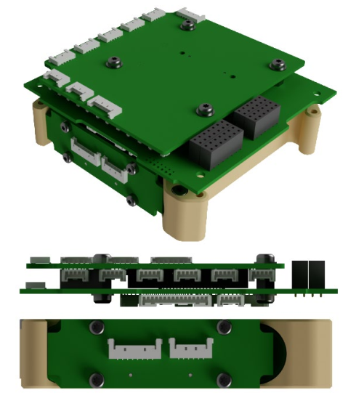
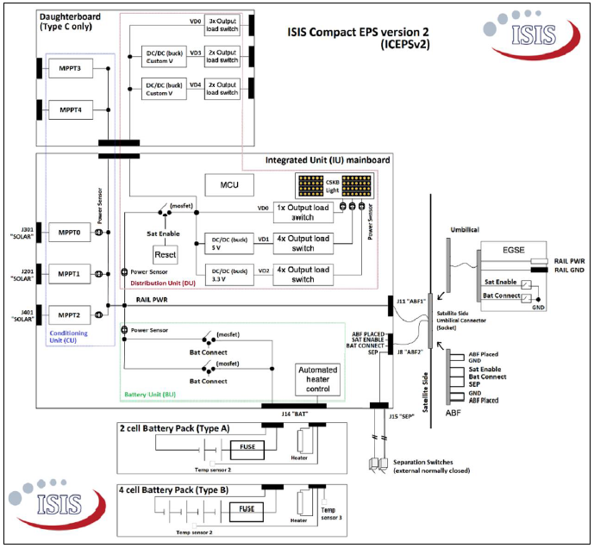
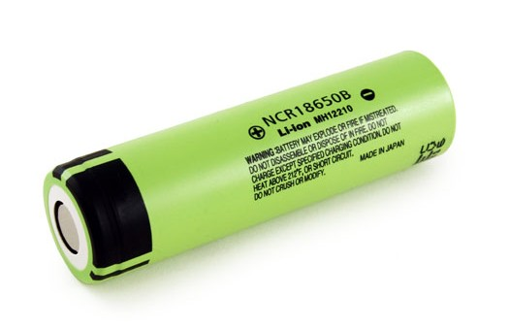
EPS Components [1/4]
ISIS Modular EPS Type C: Integrated PCDU and Battery
Configuration: 16 V & 45 Wh battery (4S-1P, Panasonic NCR 18650B)
Configuration | Description | Note
Output | Regulated: 3.3 V (4 ch.), 5 V (3 ch.), 12 V (1 ch.) Battery bus: 12.4~16.0 V (3 ch.) | All switchable
Input | 3.5~16.0 V & < 2 A | Each channel, MPPT
Protection | Under-/over-voltage cut-off & watchdog timer | -
Power Dissipation | Typ. 90 mW | Battery heater < 2.5 W
Conversion Efficiency | Typ. 90% | Depend on loads
PCDU
Battery Pack
Integrated PCDU & Battery (Type C)
Li-ion Battery Cell
<Configuration of ISIS modular EPS type C>

Slide 15
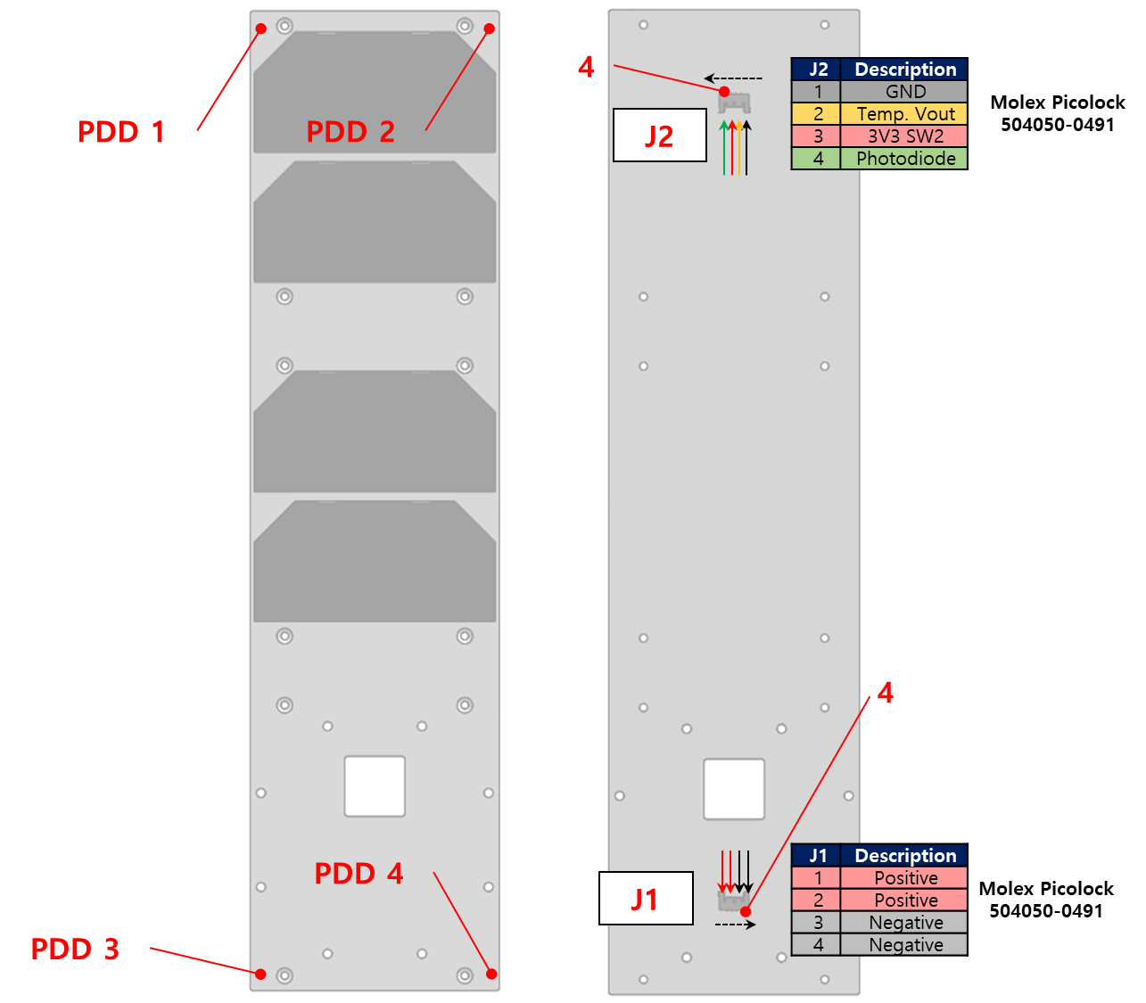
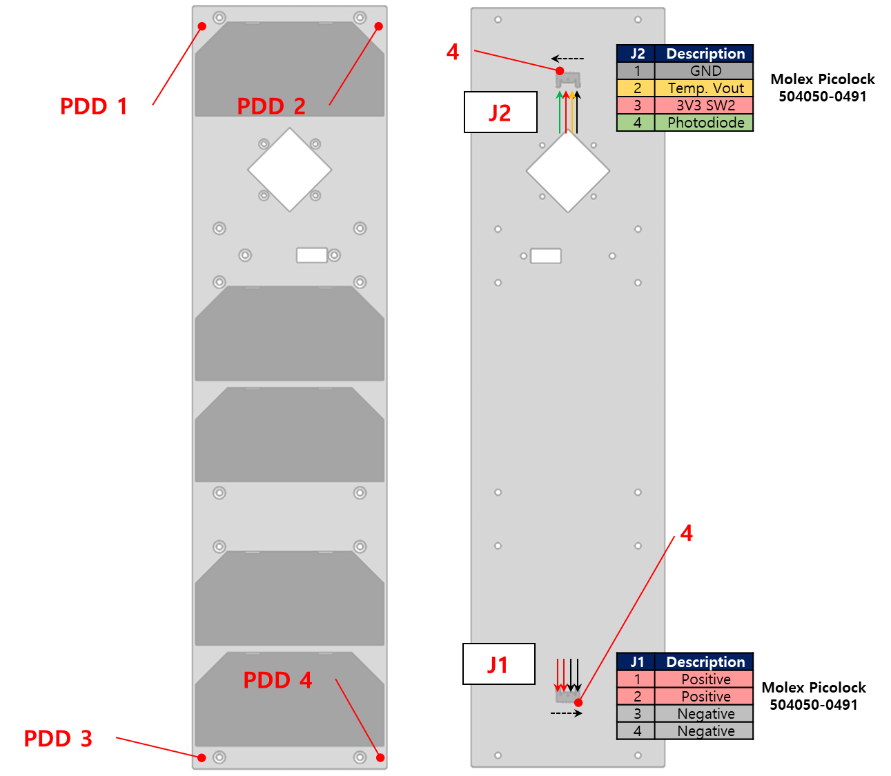
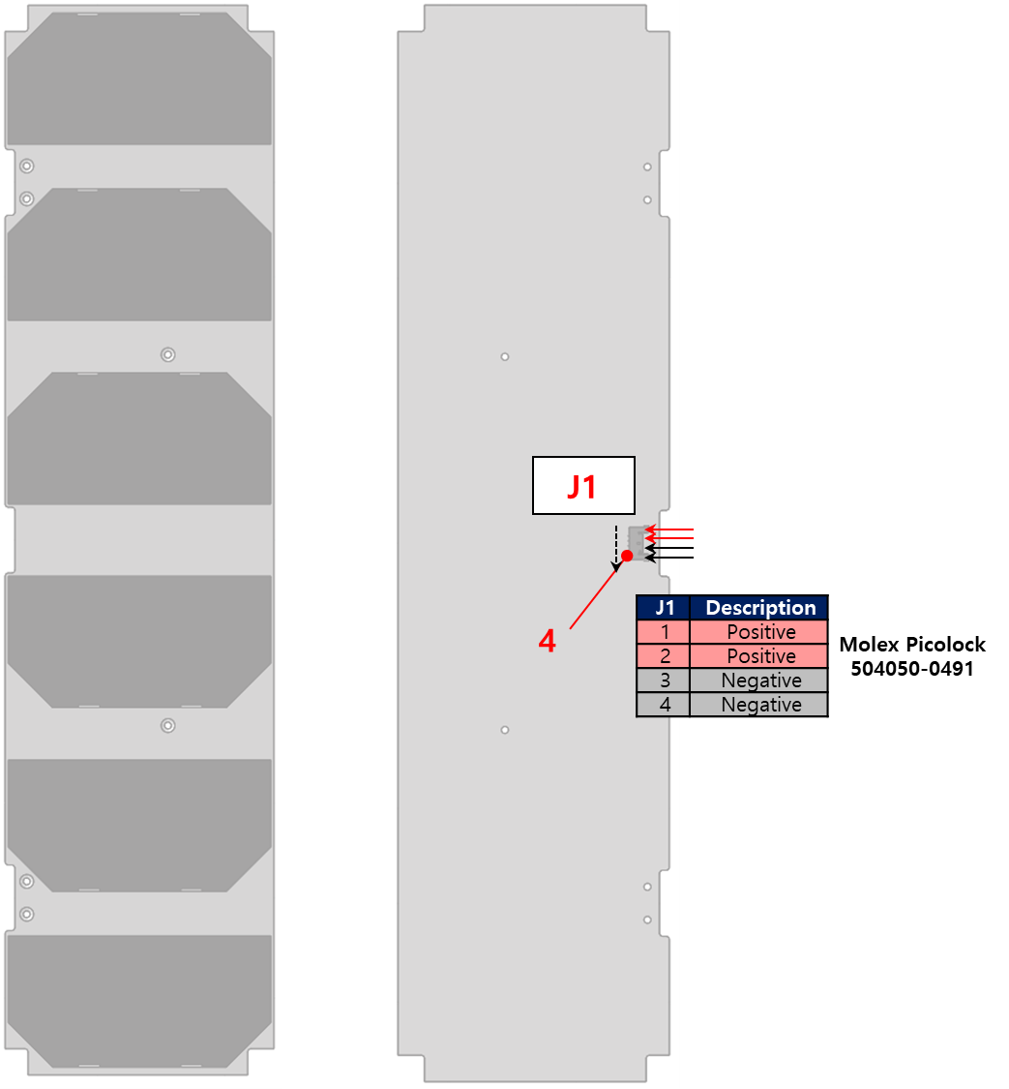
EPS Components [2/4]
Solar Array Configurations
TJ Solar Cell 3G30C (Azur Space): optimized for LEO missions at EOL
Configuration: single deployable panel & body-mounted panel
Mechanical constraint: 3U & total extrusion < 7 mm
Electrical constraint: maximum generation per channel, 3.5~16.0 V / < 2.0 A
Self-deployment mechanism: thermal knife to cut wire
Telemetry: coarse sun sensor (photo-diode) / temperature sensor
PX-BSP (4S-1P): 10.8 V & 0.5 A
MX-BSP (5S-1P): 13.5 V & 0.5 A
Y-DSP (3S-2P): 8.1 V & 1.0 A
<Configuration of solar array>

Slide 16
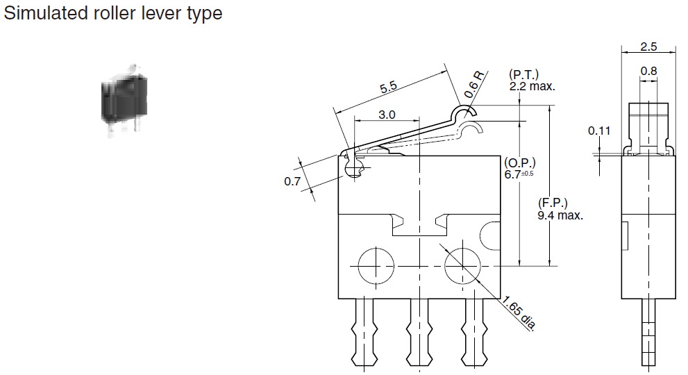
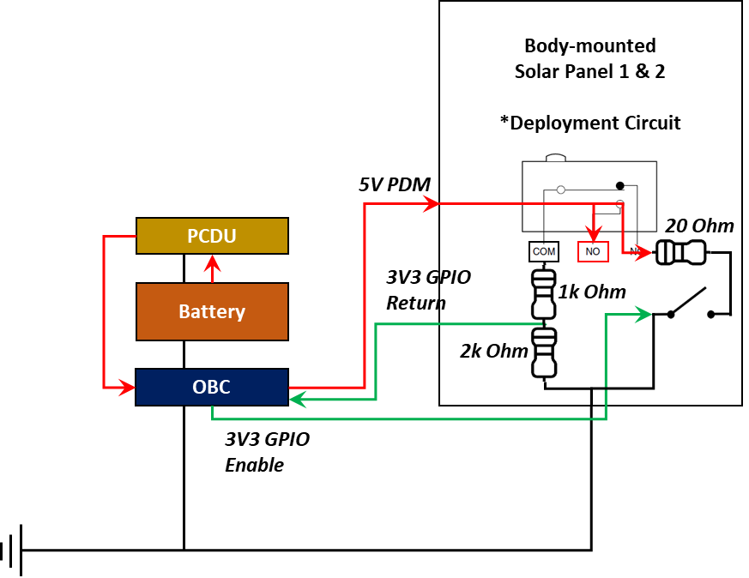
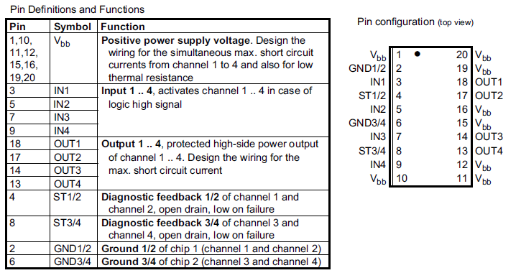
EPS Components [3/4]
Deployment Circuit
Input power
5 V PDM → < 0.4 A/circuit
Logic
PWR on → MOSFET EN → Deploy → Detect (3V3 GPIO) → MOSFET DIS → PWR off
Detect switch: Panasonic, AV404461
Mosfet switch: Infelon, BTS711L1
<Configuration of circuit for solar array deployment>

Slide 17
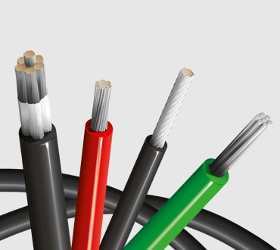
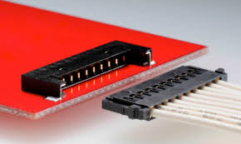
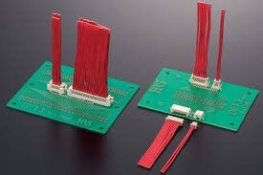
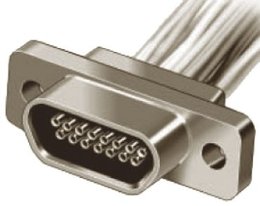
EPS Components [4/4]
Wire
Hook-up wire (Belden)
Low- outgassing, internal resistance, heat resistance
AWG24~16 (Teflon coated)
Board-to-board Connector
PicoLock (Molex) ← most EPS components
Extremely low height + (relatively) high current rate
DF13 (Hirose) ← vertical type
Easy to fabricate and connect
Micro D (Glenair) ← only star tracker
Credit: Belden
<AWG24/26 hook-up wire>
Credit: Molex
Credit: Glenair
Credit: Hirose
<Board-to-board connectors>
Notes:
TML < 1.0 , CVCM < 0.1 for aerospace application /

Slide 18
EPS Interface
Electrical Power Interface
SA
4S-1P (16.8 V)
SW
-X-axis
5S-1P
+X-axis
4S-1P
-Z-axis
2S-1P
-Y-axis
3S-2P
+Y-axis
3S-2P
BAT
Separation SW
4.2 V
Li-ion
Cell
4.2 V
Li-ion
Cell
4.2 V
Li-ion
Cell
4.2 V
Li-ion
Cell
Separation SW
RBF SW
PCDU
MPPT4
Daughter
Board
8.1 V / 1.0 A
8.1 V / 1.0 A
MPPT3
5.4 V / 0.5 A
MPPT0
10.8 V / 0.5 A
MPPT1
13.5 V / 0.5 A
MPPT2
Mother Board
12.0 V
5.0 V
3.3 V
3.3 V
3.3 V
VBATT
5.0 V
PWM
3.3 V
5.0 V
3.3 V
5.0 V
PAY
CNDH
ADCS
COMS
CAM
BBB
OBC
FSS
CSS
GPS
RX
STT
RWA
MTQ
UHF
TRX
STX
5.0 V
<EPS interface diagram>

Slide 19
Electrical Power Budget

Slide 20
Overview
Power Generation & Consumption
Required electrical power margin > 40%
Desired depth of discharge < 20%
Conversion efficiency > 90%
Electrical configurations of solar array and battery
Orbital parameter & coefficient for orientations → power generation
Average power draws considering duty rate of components
Average
Power Draw (W)
Parameter Setting
Normal & Peak Power Draw (W)
Analysis Results
<Overview of power budget calculator>

Slide 21
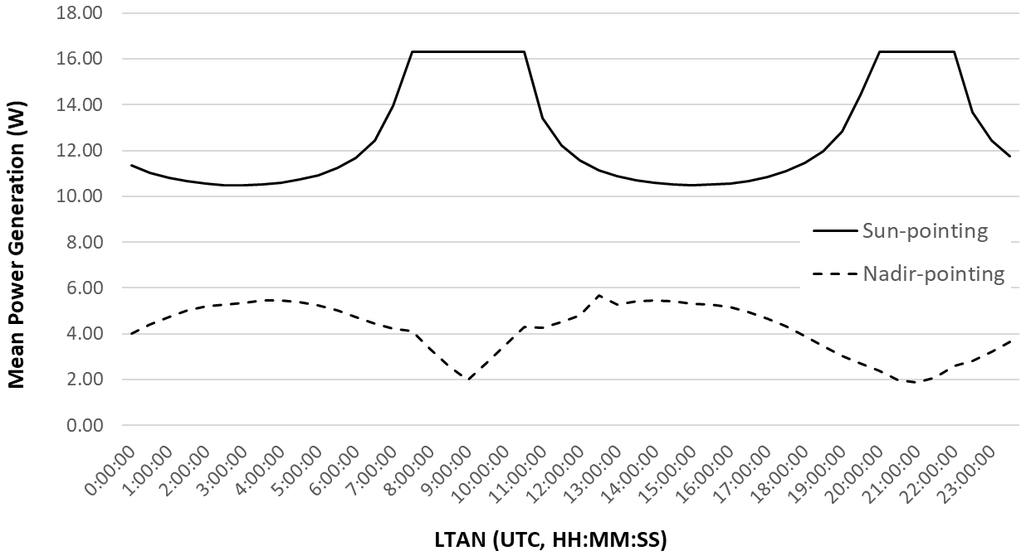
Power Generation
Mean Power Generation Analysis by LTAN & Orientation
To meet power requirements, normally orient to the Sun
Reference orbit with 700 km altitude & LTAN16 for system design & analysis
Orientation | Mean Power Generation (W)
Sun-pointing | 10.49~16.32
Nadir-pointing | 2.00~5.67
LTAN 16
10.57 W
5.15 W
<Mean power generation by LTAN & orientation>

Slide 22
System Operations
Components Duty Rate by Scenarios
Contents |  | Normal Mode |  | Mission Mode |  | Communication Mode |  | Charge Mode
Component | Sub- system | Daylight | Eclipse | Daylight | Eclipse | Daylight | Eclipse | Daylight | Eclipse
CAM | Payload | off | off | 300 sec | off | off | off | off | off
BBB | Payload | off | off | 600 sec | off | off | off | off | off
OBC | CNDH | always | always | always | always | always | always | always | always
Temp. Sensor | CNDH | always | always | always | always | always | always | always | always
IMU/MMT | ADCS | always | always | always | always | always | always | always | always
FSS/CSS | ADCS | always | always | always | always | always | always | always | always
GPS RX | ADCS | always | always | always | always | always | always | always | always
STT | ADCS | off | off | 1000 sec | off | (1000 sec) | (1000 sec) | off | off
MTQ | ADCS | 5 sec on (20% mag.) : 5 sec off | 5 sec on (20% mag.) : 5 sec off | 5 sec on (40% mag.) : 5 sec off | 5 sec on (40% mag.) : 5 sec off | 5 sec on (40% mag.) : 5 sec off | 5 sec on (40% mag.) : 5 sec off | 5 sec on (20% mag.) : 5 sec off | 5 sec on (20% mag.) : 5 sec off
RWA | ADCS | 1 sec Torque : 9 sec Speed | 1 sec Torque : 9 sec Speed | 2 sec Torque : 8 sec Speed | 1 sec Torque : 9 sec Speed | (2 sec Torque : 8 sec Speed) | (2 sec Torque : 8 sec Speed) | 1 sec Torque : 9 sec Speed | 1 sec Torque : 9 sec Speed
UHF TRX | COMS | 1 sec Tx : 30 sec Rx | 1 sec Tx : 30 sec Rx | 1 sec Tx : 30 sec Rx | 1 sec Tx : 30 sec Rx | 1 sec Tx (300 sec Tx) : 30 sec Rx | 1 sec Tx (300 sec Tx) : 30 sec Rx | 1 sec Tx : 30 sec Rx | 1 sec Tx : 30 sec Rx
S-band TX | COMS | off | off | off | off | off (600 sec Tx) | off (600 sec Tx) | off | off
PCDU | EPS | always | always | always | always | always | always | always | always
Battery | EPS | always (w/o heater) | always (w/o heater) | always (w/o heater) | always (w/o heater) | always (w/o heater) | always (w/o heater) | always (w/o heater) | always (w/o heater)
<Summary of components duty rate by scenarios>

Slide 23
Electrical Power Margin
Summary of Results
Electrical power margin > 41.42% at communication mode (> 40% always)
Required battery capacity > 18.63 Wh (with depth of discharge 20%)
Max. channel load < 1.88 A (< 2.0 A per each channel)
Operational Modes |  | Detumbling* | Normal | Mission | Communication | Charge
Power Consumption (W) | Total Average | 1.16 | 3.43 | 5.08 | 5.56 | 2.34
Peak Load (A) | 3.3 V (Mother) | 1.09 | 1.50 | 1.50 | 1.50 | 1.17
 | 5 V (Mother) | 0.41 | 0.41 | 0.63 | 1.88 | 0.41
 | 5 V (Daughter) | 0.00 | 0.00 | 0.51 | 0.00 | 0.00
 | 12 V (Daughter) | 0.00 | 0.00 | 0.47 | 0.00 | 0.00
 | VBATT (Mother) | 0.01 | 0.51 | 0.51 | 0.51 | 0.51
 | Total Battery | 1.51 | 2.42 | 3.62 | 3.89 | 2.09
Power Generation (W) | Orbit Average | 2.53 | 10.57 | 9.49 | 9.49 | 10.57
Power Margin Value (W) |  | 1.37 | 7.14 | 4.41 | 3.93 | 8.23
Power Margin (%) |  | 54.27 | 67.59 | 46.49 | 41.42 | 77.82
Battery Capacity (Wh) |  | 3.88 | 12.37 | 18.33 | 18.63 | 7.86
Battery Capacity (Ah) |  | 0.27 | 0.86 | 1.27 | 1.29 | 0.55
* Detumbling Case: MTQ duty rate = 15% & OBC/FSS/CSS/Temp. Sensor/Beacon On
<Summary of electrical power budget results>

Slide 24
Energy Balance Analysis

Slide 25
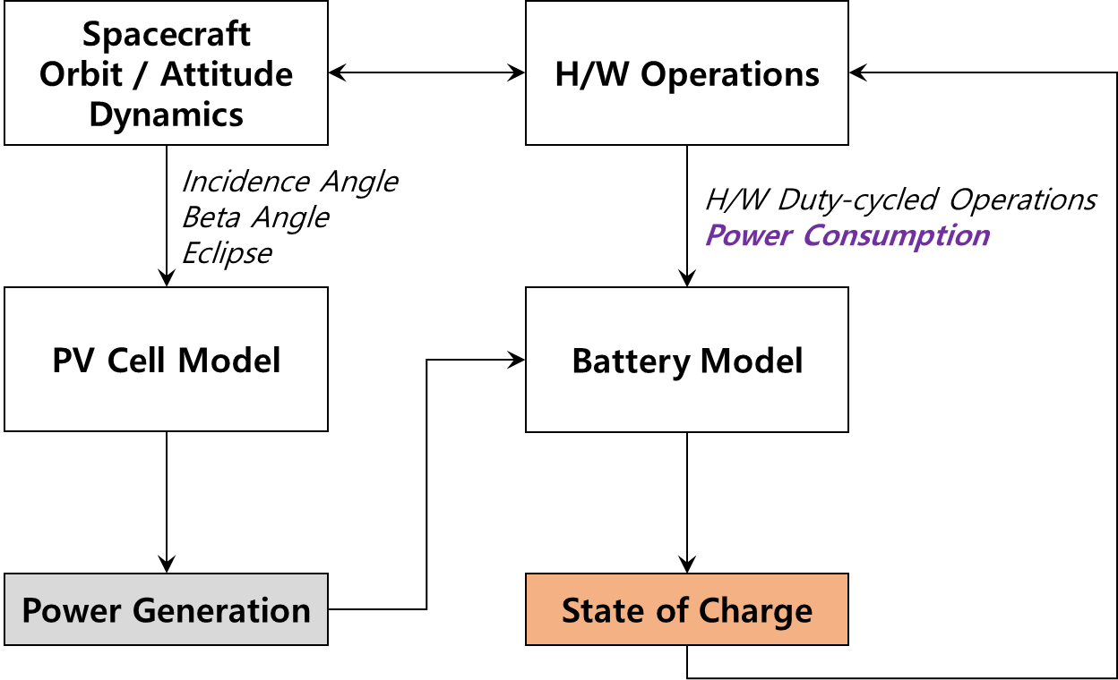
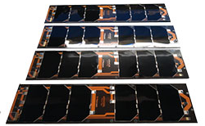
Overview
Energy Balance Analysis
Current dynamics modeling
Li-ion battery model (ISIS battery pack, 14.4 V & 45 Wh)
PV cell array model (Triple Junction AZUR solar cell, 30% efficiency)
Battery SoC affected by power generation and consumption
Balanced SoC over orbital period
Minimized DoD over mission lifetime
MPPT efficiency affected by body spins (Erb et al., 2011)
BCR with constant current charging method (fractional open circuit voltage/current)
PCM output efficiency by electrical load
Integrated PCDU & Battery (Type C)
PCDU
Battery
Solar Array
<Configuration of EPS components>
<Energy balance analysis flow diagram>

Slide 26
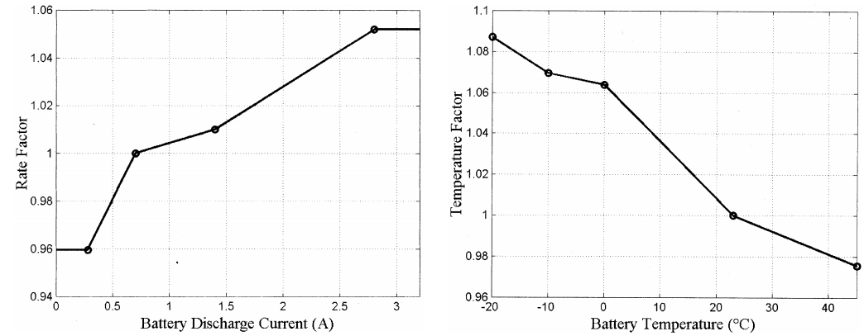
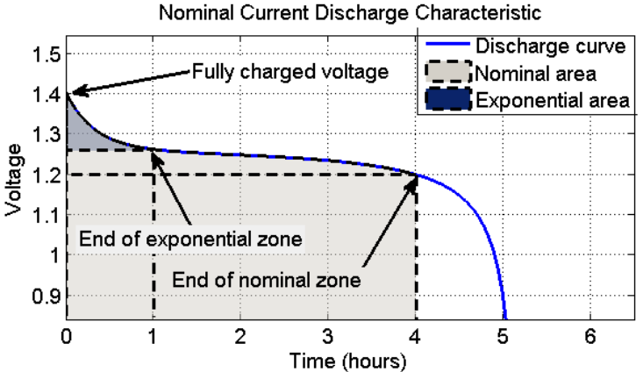






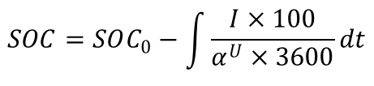



Mathematical Model [1/6]
Generic Battery Dynamic Model → “Non-linearity”
Charge current
Discharge current
Perturbations
Temperature effect, aging effect, …
$$SOC=SOC_{0}−\int{\frac{I×100}{α^{U}×3600}dt}$$
$$f_{1}=E_{0}−K\frac{Q}{Q−i_{t}}\left(i^{∗}−i_{t}\right)+Aexp(−Bi_{t})$$
$E_{0}$: constant voltage (V)
$K$: polarization resistance (Ω)
$i_{t}$: extracted capacity (Ah)
$$f_{2}=E_{0}−K\frac{Q}{i_{t}−0.1Q}i^{∗}−K\frac{Q}{Q−i_{t}}i_{t}+Aexp(−Bi_{t})$$
$i^{∗}$: low frequency current dynamics (A)
$i$ : battery current (A)
$A$ : exponential voltage (V)
$B$ : exponential capacity (Ah⁻¹)
<Dynamic Li-ion battery model for system simulation (Mathworks)>
Notes:
MATLAB Simulation Model for Dynamic Mode of the Lithium-ion Batteries to Power the EV (Baboselac, 2017)
A Generic Battery Model for the Dynamic Simulation of Hybrid Electric Vehicle (Tremblay, 2007)
Dynamic Lithium-Ion Battery Model for System Simulation (Gao, 2002)

Slide 27
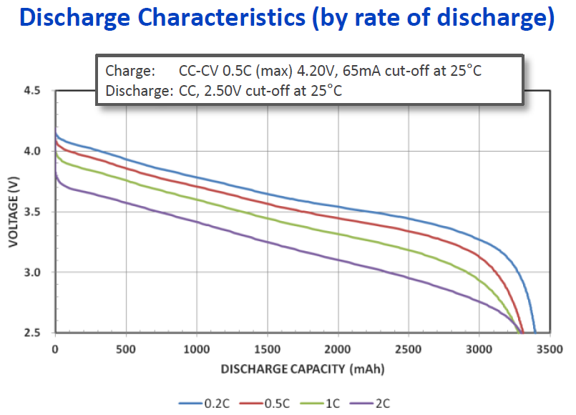
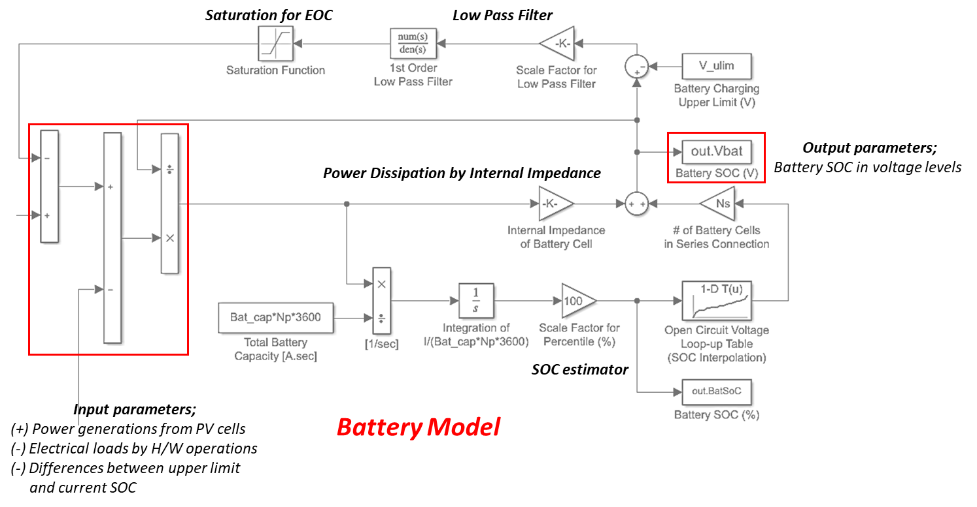
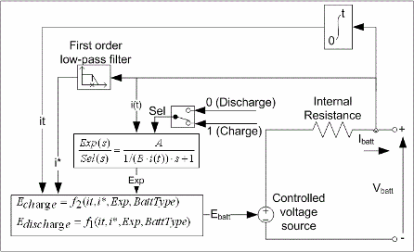
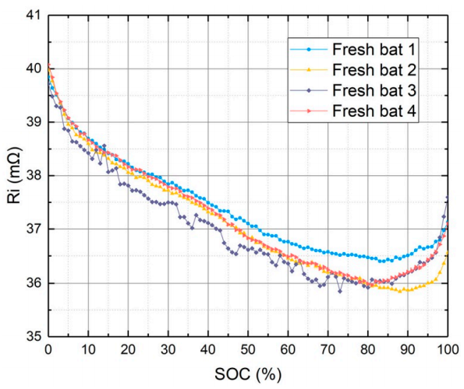
Mathematical Model [2/6]
Li-ion Cell: NCR 18650B (Panasonic)
Nominal voltage: 3.6 V (2.5~4.2 V) & capacity: 3.25~3.35 Ah
Reference voltage: 0.2-C open circuit voltage (OCV)
EOC mode (with 1st order low-pass filter): 4.0 V
Constant internal resistance: 39 mΩ at 25℃ (Wang, 2017)
<Li-ion battery model and general characteristics of NCR 18650B>
Notes:
https://kr.mathworks.com/help/physmod/sps/powersys/ref/battery.html
https://kr.mathworks.com/help/sldo/examples/estimate-model-parameters-per-experiment-code.html

Slide 28


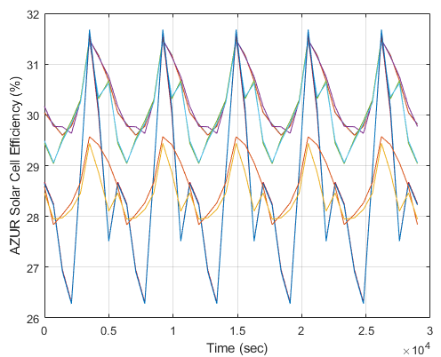

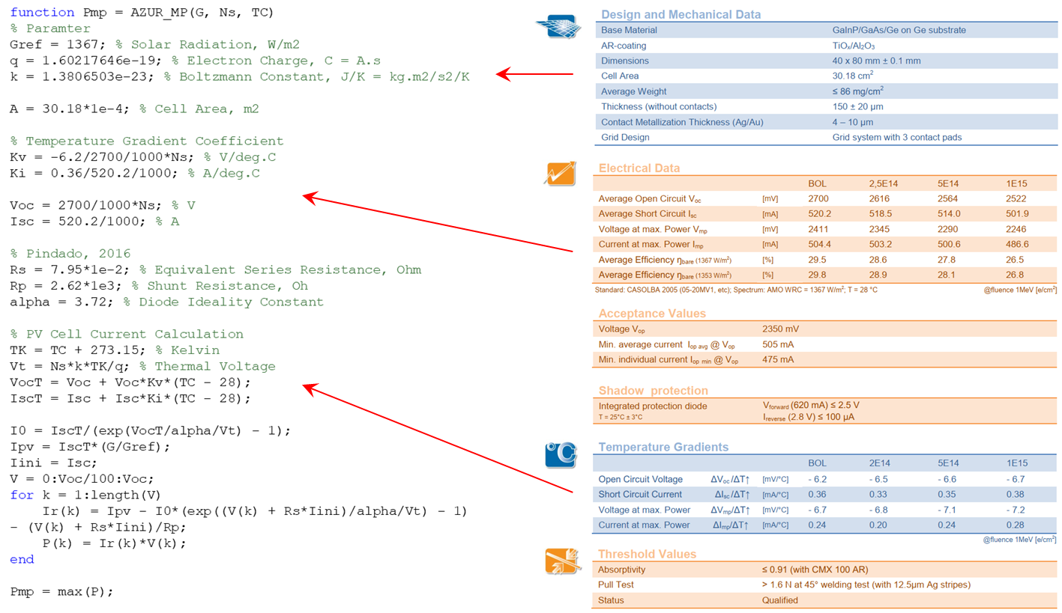
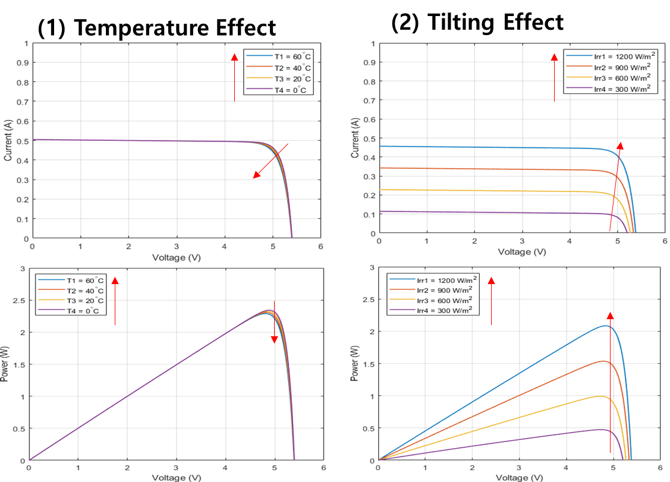
Mathematical Model [3/6]
PV Cell: Azur Space Triple Junction Solar Cell 30% Efficiency
Current dynamics (Villalva, Gazoli, and Filho, 2009)
* : thermal voltage
<PV cell model with general characteristics>

Slide 29
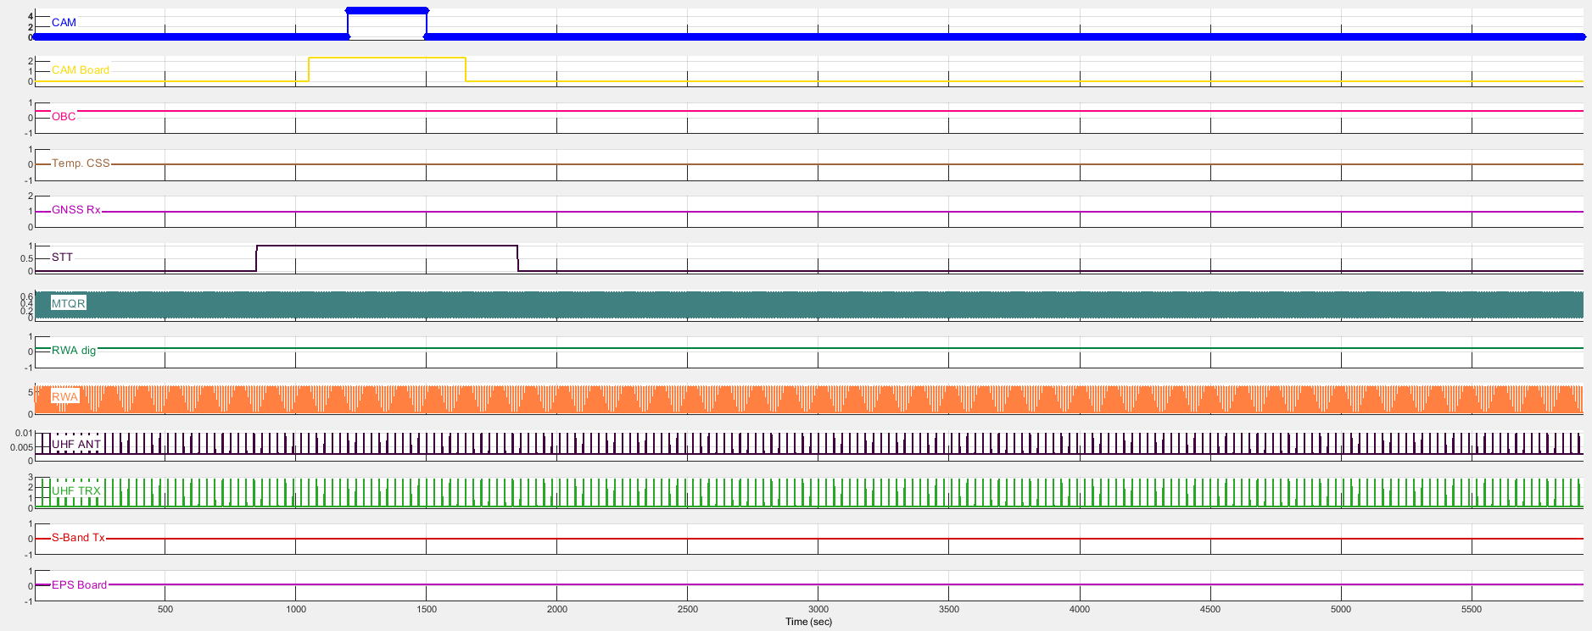
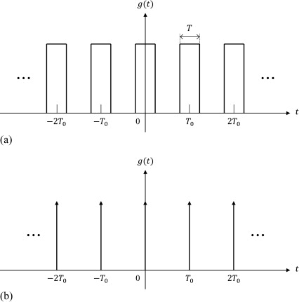
Mathematical Model [4/6]
Electrical Load
Current draw in battery model
Generated power (W) + “electrical load” (W) = battery charge & discharge rate
Type
Continuous (constant); OBC, FSS/CSS, PCDU, RWA speed, …
Spike (peak); RWA torque, inrush, …
Pulse (rectangular, trapezoidal, sawtooth, …); MTQ, PPS, …
<Electrical load model and examples>

Slide 30
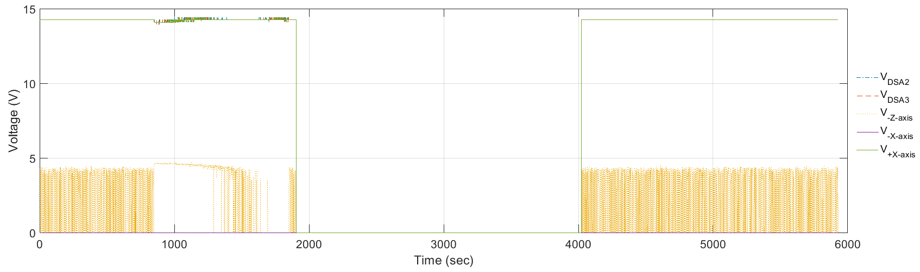
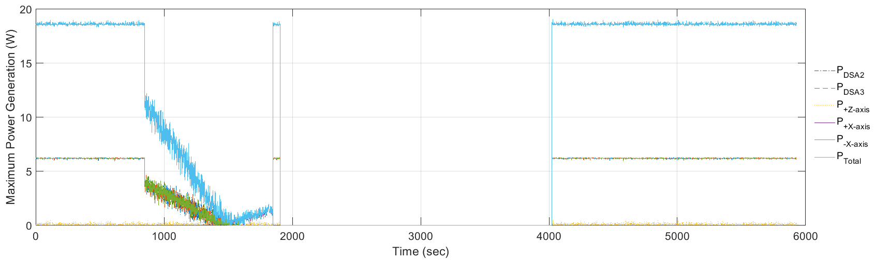
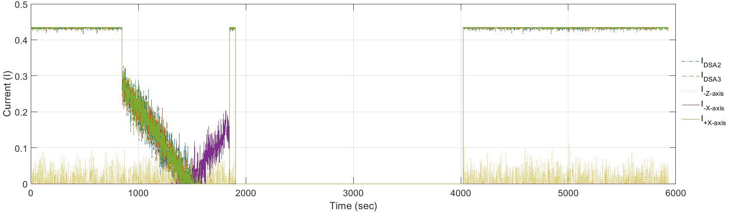
Mathematical Model [5/6]
Conversion Efficiency of Regulators
Solar input to battery
Allowable input voltage range, 3.5~16.0 V
Efficiency w.r.t input voltage range, 80~95%
** Performance degradations by temperature, body spins & inherent effects
Battery to switch output
Output conversion efficiency w.r.t electrical loads of each channel, 70~95%
Solar Input to Battery
Convertor Chain Efficiency
Efficiency
Load Current (A)
Battery to Switch Output
Convertor Chain Efficiency
Solar Input to Battery: Voltage
Efficiency
Solar Input to Battery: Current
Solar Input to Battery: Triggered Energy
Load Current (A)
<Example profiles of solar input with allowable voltage & current values>
<Conversion efficiency of regulator by electrical loads (ISIS modular EPS type C)>

Slide 31
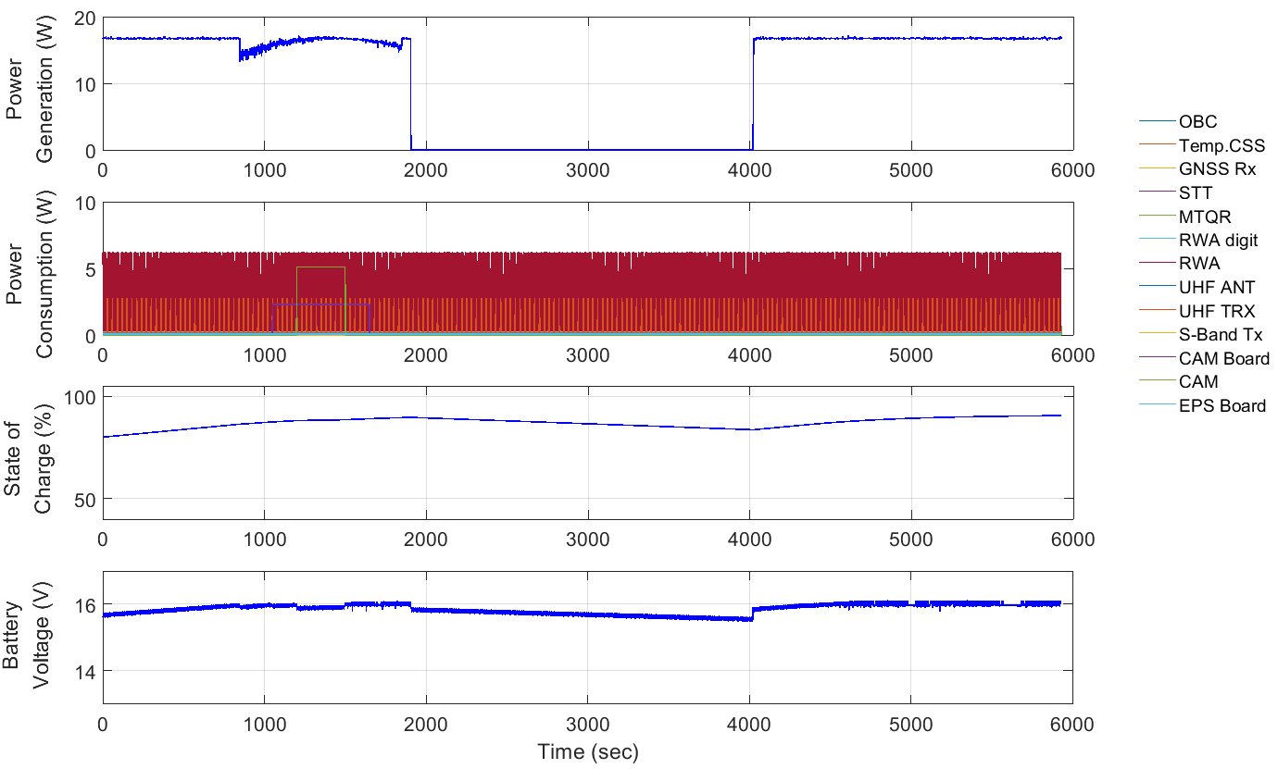
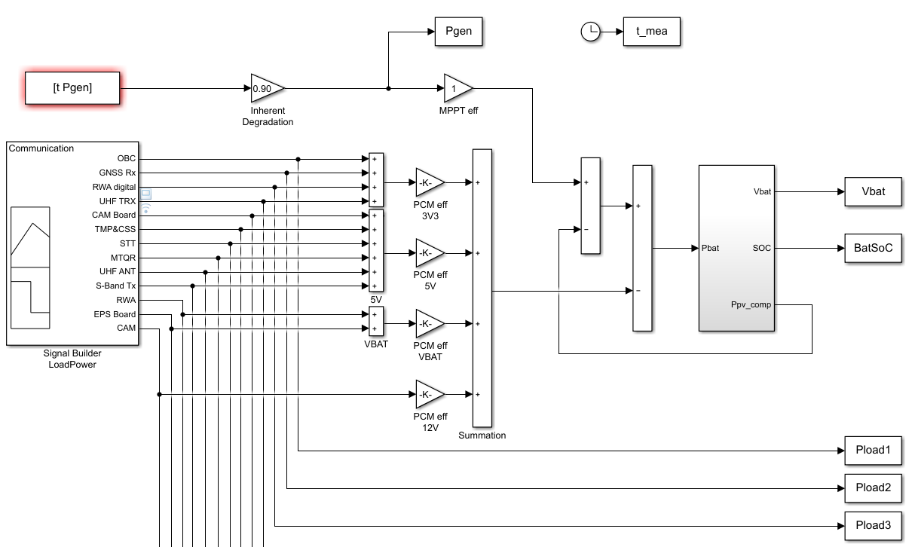
Mathematical Model [6/6]
Integrated Mathematical Models
Closed-loop simulation for scenarios
Power Generation Input
*Orbit/Attitude Dynamics
Battery Capacity Output
Electrical Load
Battery Model
Conversion Efficiency
<Integrated mathematical models for energy balance analysis>

Slide 32
Simulation Results [1/2]
State-of-charge Profiles in Battery Voltage Level
DOD < 20% & SOC > 50% (initial SOC, 80%) over 1-period
Considered orbit & attitude dynamics with uncertainties
Pointing accuracy, 13 deg (3σ) ← orientation changes by mission scenarios
Considered conversion efficiency & cut-off range of solar array input
H/W component duty rate by mission scenarios
SOC estimation based on OCV profiles
Mode | Average Power Generation (W) | DOD (%) | End of SOC (%)
Normal | 11.82 | 10.62 | 90.62
Mission | 11.82 | 13.20 | 90.50
Comm. Day | 9.47 | 10.50 | 88.75
Comm. Eclipse | 11.94 | 10.39 | 90.00
Emergency | 11.82 | N/A (30.81) | 80.81
Orientation Changes
*Initial SOC of Emergency Mode = 50%
<Example profiles of generated/consumed power &
battery state-of-charge in mission mode>
<Summary of energy balance analysis
results by scenarios>

Slide 33
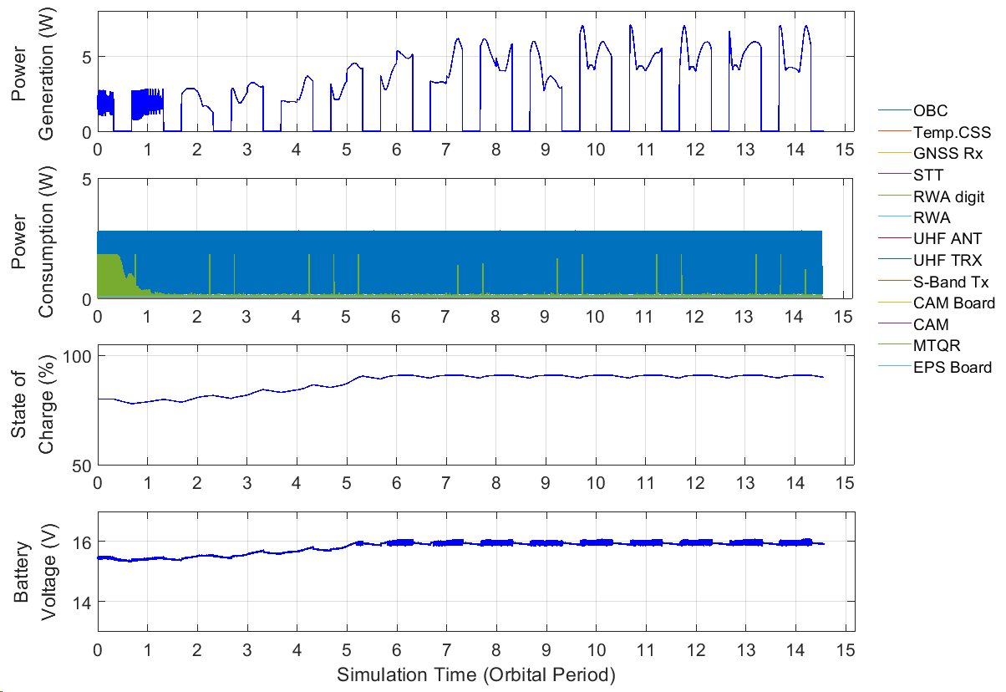
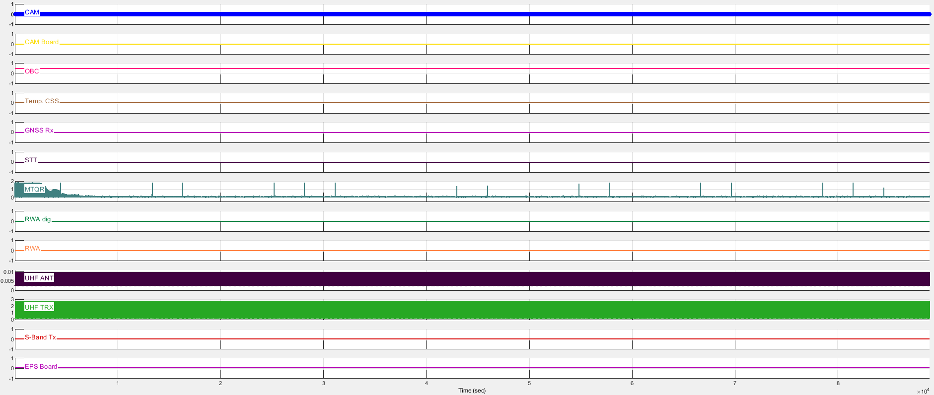
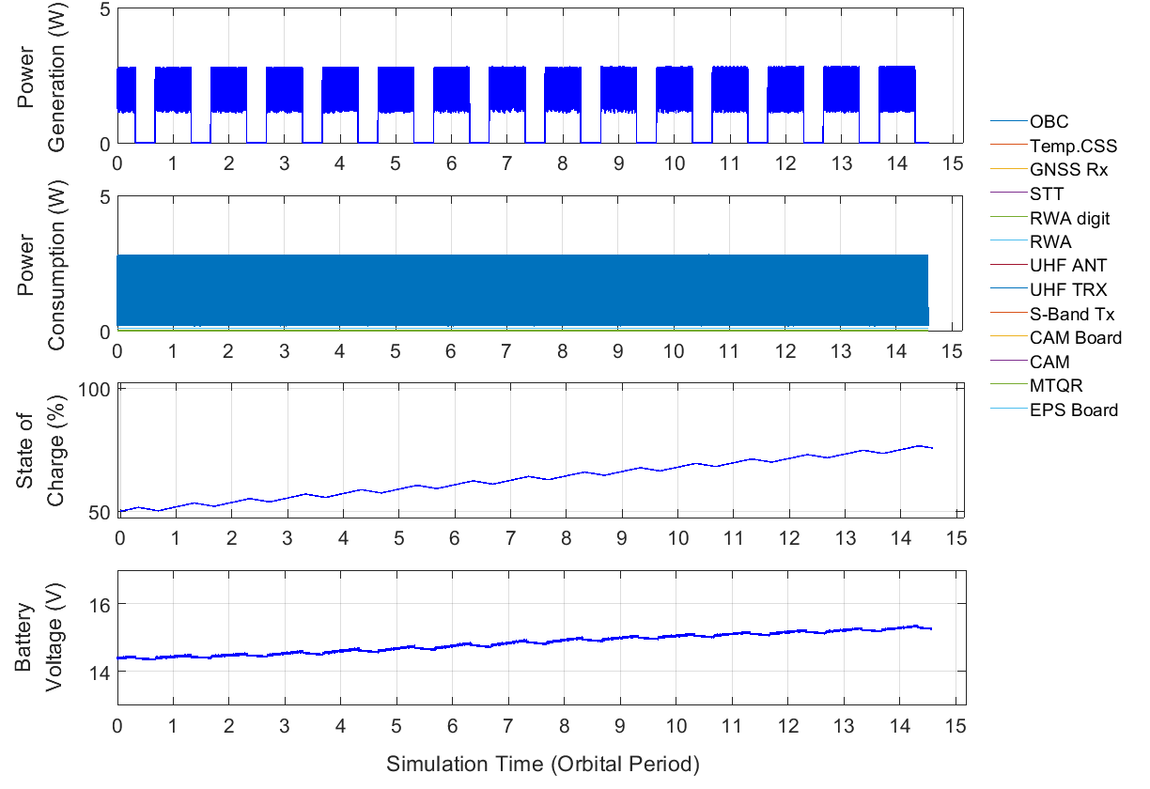
Simulation Results [2/2]
Survivability Analysis in LEOP → “Charging”
1-day operations & stowed configuration
Basic operations; (antenna deployment) beacon, detumbling, HK monitoring, …
Prolonged detumbling periods & (partially) fail to stabilize initial angular velocity
[Case 1]
[Case 2]
Case | Description | Initial ω (deg/sec) | MPPT eff. (%) | Initial SOC (%) | End of SOC (%)
1 | Detumbling Success | 20 (in each axis) | 40~90 | 80 (15.5 V) | 89.93 (15.94 V)
2 | Detumbling Fail (No Control) | 20 (in each axis) | 40 | 50 (14.4 V) | 76.71 (15.29 V)
3 | Detumbling Partially Fail 1 (No Control) | 10 (in each axis) | 60 | 50 (14.4 V) | 89.97 (15.94 V)
4 | Detumbling Partially Fail 2 (No Control) | 5 (in each axis) | 80 | 50 (14.4 V) | 89.96 (15.94 V)
5 | Detumbling Partially Fail 3 (No Control) | 1 (in each axis) | 90 | 50 (14.4 V) | 89.96 (15.94 V)
<Summary of energy balance analysis results in LEOP>

Slide 34
Verification Plan

Slide 35
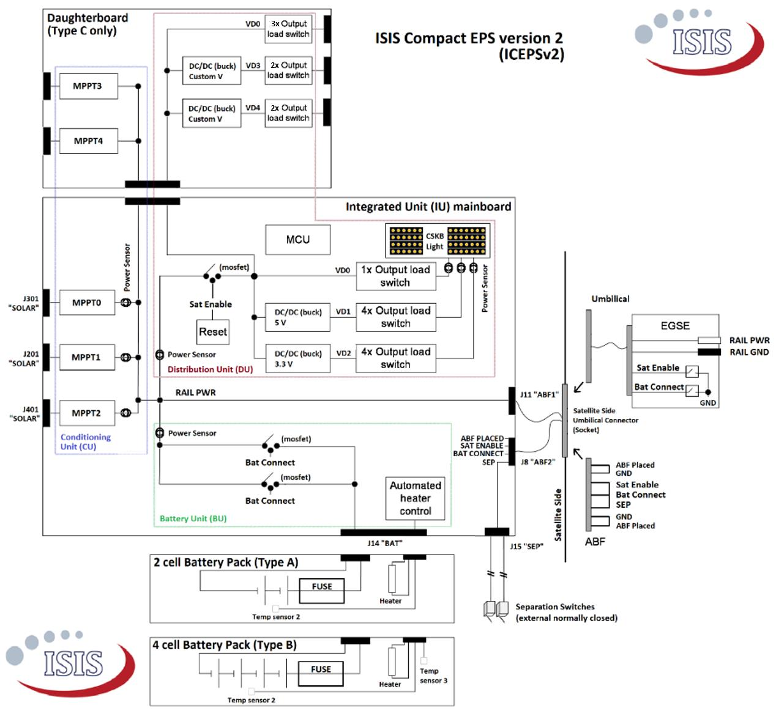
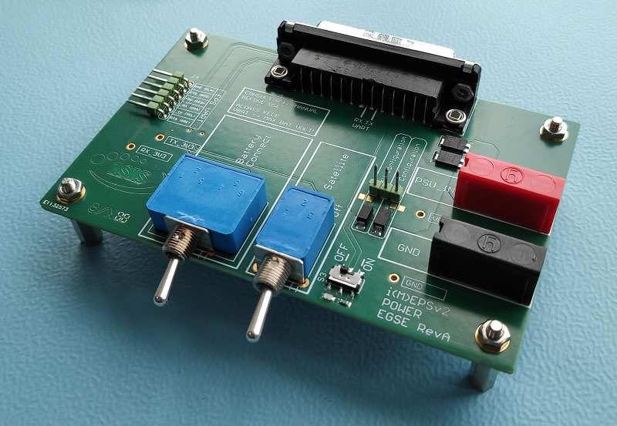
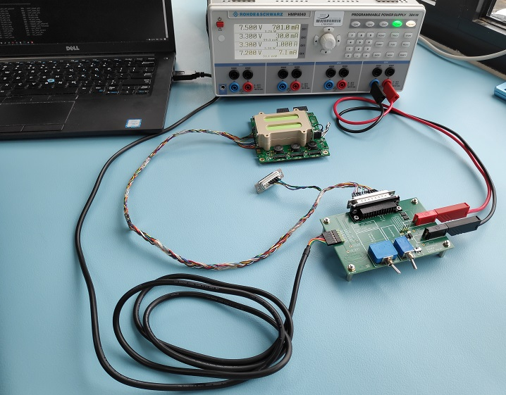
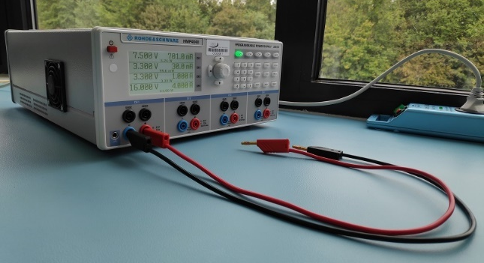
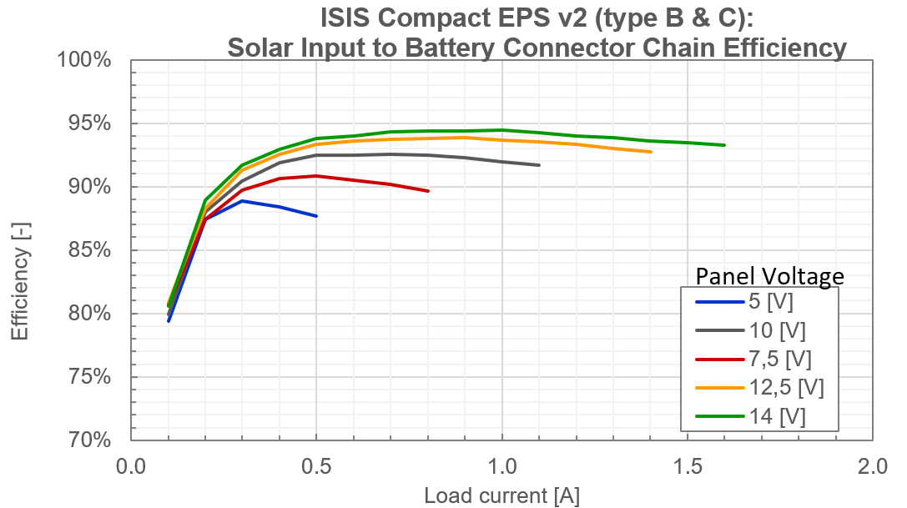
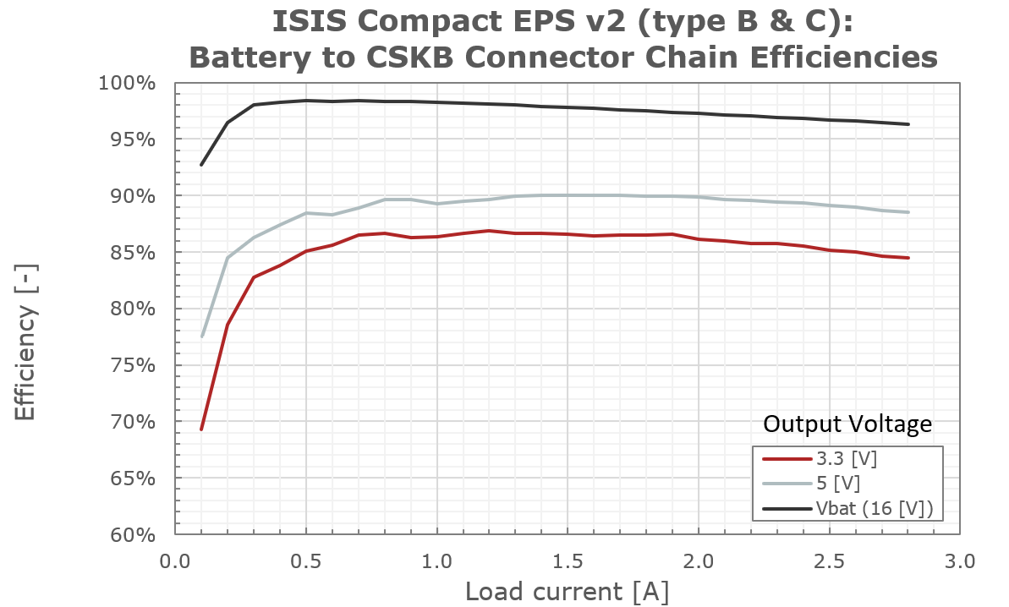
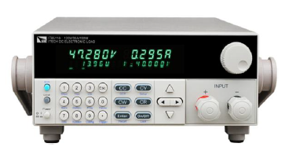
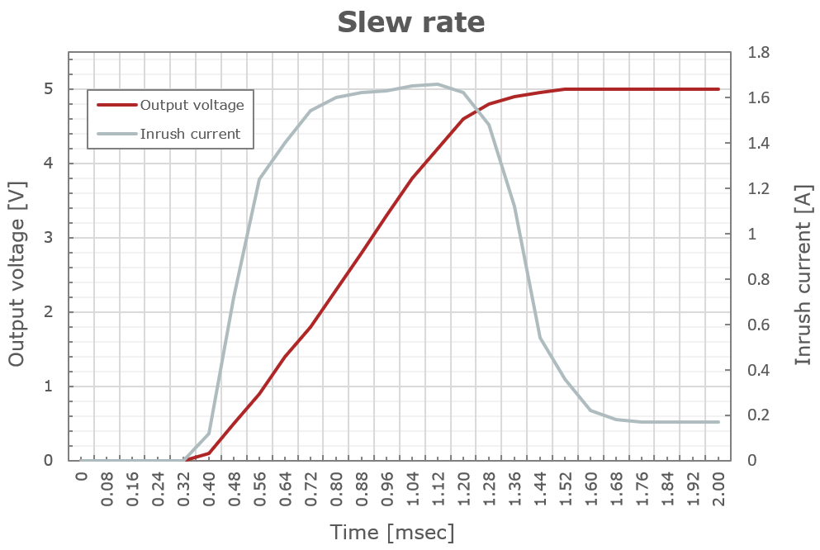
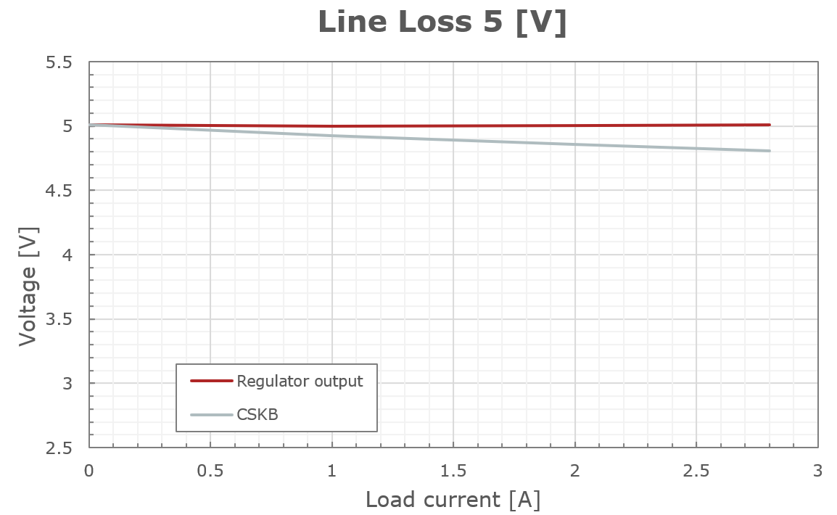
Component Level Testing [1/2]
Integrated EPS Module Type C
Activation & RBF switch logic; systems shut-down or boot with external switches for each channel
Check telemetry & telecommand via I2C communication
Switch functionalities; on-off operations delay, output voltage & current
Electrical loads using external power supply and electrical load device
Evaluate conversion efficiency of regulators, line loss, …
Integrated PCDU & Battery (Type C)
Test List
EGSE
<Example configuration of integrated EPS module testing>

Slide 36
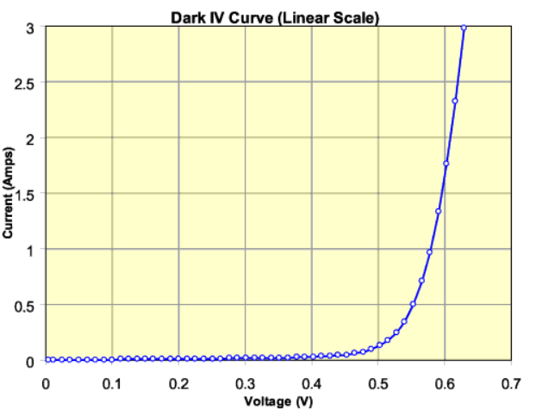
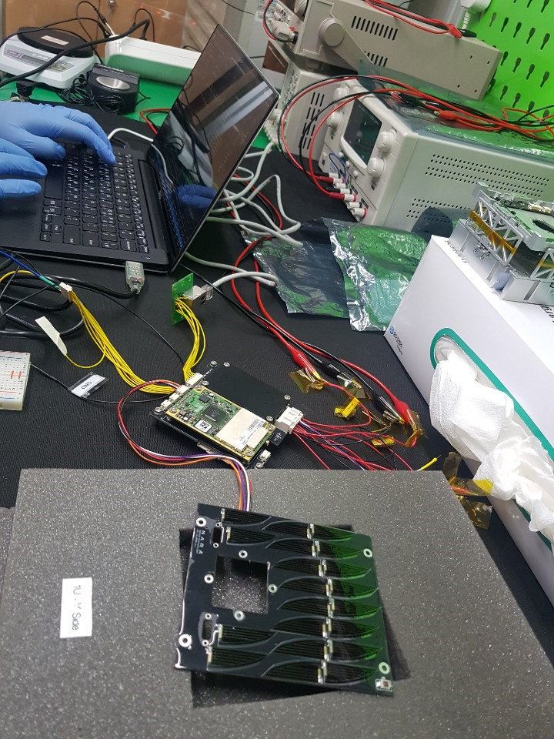
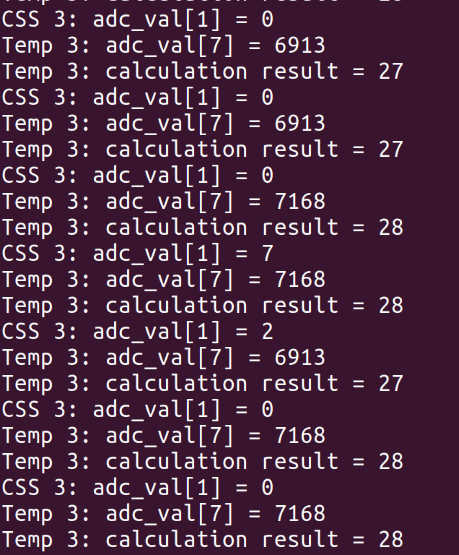
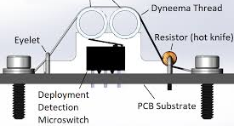
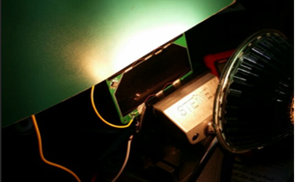

Component Level Testing [2/2]
Solar Array and Sensors
Measure dark current and evaluate its bypass diode
Check solar array output measurement with halogen lamp or sunlight
Check Telemetry & telecommand of sensors; photodiode, temp. sensor, …
Solar Array Deployment Circuit
Check deployment logic by switch status and power supply
Check duration of thermal knife operations
Damkjar, 2019
<Example configuration of solar array and deployment circuit testing>

Slide 37



Integration Level Testing
Integrated EPS Module Type C & Solar Array
Check telemetry & telecommand via I2C communication
Repeat component level testing sequences
Measure solar array output and compare with MPPT input
Light source using halogen lamp or outdoor sunlight
Rotation
0~180 deg
Compare with solar array input on
PCDU’s MPPT port
Light Source
Post, 2013
Measure solar array output as analog values
<Example configuration of integrated EPS module and solar array>
Notes:
https://www.researchgate.net/publication/275460703_A_Low-Cost_Photodiode_Sun_Sensor_for_CubeSat_and_Planetary_Microrover

Slide 38
Conclusion

Slide 39
Summary
EPS Configurations & Specifications
Components; PCDU, Li-ion battery, solar array, deployment circuit, …
Electrical interface; solar array input & battery output for each channel
Specifications w.r.t. requirements & constraints → “compliable”
EPS Analysis
Power budget management
EPS mathematical model design
Energy balance analysis; integrated electrical power simulation by scenarios
EPS Verification Plan
Component level testing plan
Integration level testing plan

Slide 40
Issue and Concern
Issue
From thermal analysis results, battery stack has low temperature margin
Solution 1) evaluation of thermal analysis results; consultation, STM testing
Solution 2) insulation using Kapton or MLI/SLI
Solution 3) change the location of battery in structure model
Concern
Lack of detailed battery specifications due to none-flight heritage version
Advanced model based on flight heritage model (since 2018)
Solution 1) limit DOD during operations within 15% (smaller than recommendation)
Solution 2) local testing using NCR 18650B li-ion battery cell
Over current during integration testing
Solution 1) time-sharing of H/W duty rate and evaluate through ETB testing
Solution 2) utilize redundant channel for component with high-current draw
Survival during LEOP
Solution 1) set on-orbit configurable conditions for detumbling end

Slide 41





Future Works
Summary of Main Schedule
Near-term
Set-up for component level testing environment based on verification plan
Evaluation of current design through local interface & function testing
Deployment circuit logic & performance
Photodiode & temperature sensor bit resolution with amplifier
Battery cell charge & discharge testing
Long-term
EPS component level testing after delivery of COTS
EPS integration level testing before ETB flat-sat testing
<Example configuration of EPS testing>

Slide 42
Question & Answer
Thank You for Your Attention

Slide 43
Appendix.

Slide 44

Risk Management [1/2]
ID | Detection | Solar Array |  | Battery |  | Solution
 |  | Deployment | Low Power Generation | Heater | Sensors
EPS-01 | NO battery telemetry (Battery Temperature) |  |  |  |  | FSW reboot by OBC WDT System reboot by PCDU WDT
EPS-02 | Low battery temperature (Heater Enable Telemetry) |  |  |  |  | Attitude control to heat battery (passive thermal control based on thermal analysis)
EPS-03 | Anomaly in PCDU telemetry (PCDU BCR Voltage, Current) |  |  |  |  | Check a location of damaged solar array Orient to Sun for maximum power generation (tumbling & emergency)
EPS-04 | NO deployment switch signal (Tact Switch GPIO Signal) |  |  |  |  | Check PCDU telemetry Retry to deploy solar array by telecommand (tumbling & emergency)
EPS-05 | NO system responses |  |  |  |  | System reboot by PCDU WDT (generally, it’s a mission failure!)

Slide 45
Risk Management [2/2]
ID | Detection | PCDU |  |  |  | Solution
 |  | BCR | PDM Switch | WDT | I2C
EPS-06 | NO PCDU telemetry (Battery Voltage, Temperature) |  |  |  |  | FSW reboot by OBC WDT System reboot by PCDU WDT
EPS-07 | Fail to contact (Telecommunication failure) |  |  |  |  | Wait system reboot other devices (FSW reboot by OBC command)
EPS-08 | Anomaly in PCDU / component telemetry (PDM Voltage, Current) |  |  |  |  | Compare subsystems telemetry with PCDU PDM telemetry FSW reboot by OBC WDT Disable / Isolate damaged PDM
EPS-09 | Anomaly in BCR telemetry (BCR Voltage, Current) |  |  |  |  | Check PCDU BCR telemetry PCM reboot or system reboot
EPS-10 | NO system responses |  |  |  |  | System reboot by PCDU WDT (generally, it’s a mission failure!)
EPS-11 | NO PDM output or disable to control status |  |  |  |  | Compare subsystems telemetry with PCDU PDM telemetry FSW reboot by OBC command Change system operations
EPS-12 | NO power generation (BCR telemetry) |  |  |  |  | FSW reboot by OBC command (generally, it’s a mission failure!)

Slide 46
Product Assurance Plan
Risk
5
4
3 | EPS-04 |  | EPS-05 EPS-06 | EPS-08 | EPS-07 EPS-10
2 | EPS-02 |  | EPS-03 | EPS-09 | EPS-11 EPS-12
1 | EPS-01
 | 1 | 2 | 3 | 4 | 5
Probability of Occurrence
Impact of Occurrence
Scale | Probability of Occurrence | Impact of Occurrence
5 | Almost Certain | Technical goals cannot be reached
4 | Highly Probable | Significant degradation in technical performance
3 | Probable | Moderate reduction of technical performance
2 | Possible | Small reduction in technical performance
1 | Improbable | Minimal or no consequence

Slide 47
EPS Schedule [1/5]
Main Tasks
: Scheduled
: Progress
Year
2019
2020
PDR
CDR
2021
Month
6 | 7 | 8 | 9 | 10 | 11 | 12 | 1 | 2 | 3 | 4 | 5 | 6 | 7 | 8 | 9 | 10 | 11 | 12 | 1 | 2 | 3 | 4 | 5 | 6 | 7 | 8 | 9 | 10 | 11 | 12
EPS Survey
EPS Design
EPS H/W Development
EPS Verification

Slide 48
EPS Schedule [2/5]
Detailed Tasks
: Scheduled
: Progress
Year
2019
2020
PDR
CDR
2021
Month
6 | 7 | 8 | 9 | 10 | 11 | 12 | 1 | 2 | 3 | 4 | 5 | 6 | 7 | 8 | 9 | 10 | 11 | 12 | 1 | 2 | 3 | 4 | 5 | 6 | 7 | 8 | 9 | 10 | 11 | 12
EPS Survey
Configuration of EPS
Detailed Function of Components
COTS Selection
Design and Verification Methods

Slide 49
EPS Schedule [3/5]
Detailed Tasks
: Scheduled
: Progress
Year
2019
2020
PDR
CDR
2021
Month
6 | 7 | 8 | 9 | 10 | 11 | 12 | 1 | 2 | 3 | 4 | 5 | 6 | 7 | 8 | 9 | 10 | 11 | 12 | 1 | 2 | 3 | 4 | 5 | 6 | 7 | 8 | 9 | 10 | 11 | 12
EPS Design
Requirements and Constraints
Design and Budget Analysis
EPS Internal/ External Interfaces
Energy Balance Simulation

Slide 50
EPS Schedule [4/5]
Detailed Tasks
: Scheduled
: Progress
Year
2019
2020
PDR
CDR
2021
Month
6 | 7 | 8 | 9 | 10 | 11 | 12 | 1 | 2 | 3 | 4 | 5 | 6 | 7 | 8 | 9 | 10 | 11 | 12 | 1 | 2 | 3 | 4 | 5 | 6 | 7 | 8 | 9 | 10 | 11 | 12
EPS H/W Development
Solar Panel Deployment Device
Pin-out & Data I/O
Component Performance Testing
Component Functional Testing

Slide 51
EPS Schedule [5/5]
Detailed Tasks
: Scheduled
: Progress
Year
2019
2020
PDR
CDR
2021
Month
6 | 7 | 8 | 9 | 10 | 11 | 12 | 1 | 2 | 3 | 4 | 5 | 6 | 7 | 8 | 9 | 10 | 11 | 12 | 1 | 2 | 3 | 4 | 5 | 6 | 7 | 8 | 9 | 10 | 11 | 12
EPS Verification
PCDU/ Battery Flat-sat Testing
PCDU/Solar Array Flat-sat Testing
EPS End-to-end Testing

Slide 52
Wire Diagram [1/4]
Solar Panel: Body-mounted
(-X) 5S-1P
(+X) 4S-1P
(+Z) 2S-1P
Body-mounted
Body-mounted
Body-mounted
Umbilical External Charging Port
Mother Board
Daughter Board
5.4 V & 0.5 A
MPPT 0
10.8 V & 0.5 A
MPPT 1
13.5 V & 0.5 A
MPPT 2
Molex Picolock
504050-0491
Molex Picolock
504050-0491
P1 | Description
1 | Positive
2 | Positive
3 | Negative
4 | Negative
P1 | Description
1 | Positive
2 | Positive
3 | Negative
4 | Negative
MPPT 4
CSKB
MPPT 3
BRF +X
P2 | Description
1 | GND
2 | Temp. Vout
3 | 3V3 SW2
4 | Photodiode
P2 | Description
1 | GND
2 | Temp. Vout
3 | 3V3 SW2
4 | Photodiode
BRF +Y
<Solar array to PCDU (mother) wire diagram>
Solar Panel Side Connector

Slide 53
Wire Diagram [2/4]
Solar Panel: Deployable [1/2]
(+Y) 3S-2P
(-Y) 3S-2P
(+Y) Body-mounted
(-Y) Body-mounted
BRF +X
Deployable
Deployable
Front
Molex Picolock
504050-0291
BRF +Y
Front
P1 | Description
1 | Positive
2 | Negative
Molex Picolock
504050-0291
Mother Board
P1 | Description
1 | Positive
2 | Negative
Via
Daughter Board
P2 | Description
1 | Positive
2 | Positive
3 | Negative
4 | Negative
Via
P2 | Description
1 | Positive
2 | Positive
3 | Negative
4 | Negative
MPPT 0
Molex Picolock
504050-0491
MPPT 1
Molex Picolock
504050-0491
MPPT 2
Molex Picolock
504050-0291
8.1 V &
1.0 A
MPPT 4
CSKB
P1 | Description
1 | Positive
2 | Negative
MPPT 3
Molex Picolock
504050-0291
8.1 V &
1.0 A
P1 | Description
1 | Positive
2 | Negative
Solar Panel Side Connector
<Solar array to PCDU (daughter) wire diagram>

Slide 54



Wire Diagram [3/4]
Solar Panel: Deployable [2/2]
Panel to PCDU
Molex Picolock
504050-0291
P1 | Description
1 | Positive
2 | Negative
P1 | Description
1 | Positive
2 | Negative
Molex Picolock
504050-0291
Via
P2 | Description
1 | Positive
2 | Positive
3 | Negative
4 | Negative
Molex Picolock
504050-0491
<Solar array to PCDU wire diagram>

Slide 55
Wire Diagram [4/4]
Electrical Interface Board: ADCS
Molex Picolock
504050-0891
On-board Computer
Bottom View
(+X)
Body-mounted
Solar
Panel
4S-1P
(-X)
Body-mounted
Solar
Panel
5S-1P
(+Y)
Body-mounted
Only
PCB
(-Y)
Body-mounted
Only
PCB
(+Z)
Body-mounted
Solar
Panel
2S-1P
P5 | Description
- | -
7 | 3V3 SW2
6 | SPI CS1
5 | SPI MOSI
4 | SPI SCK
3 | Photodiode
2 | GND
1 | GND
CSS/Temp
RWA/STT
Electrical Interface Board (ADCS)
Top View
P5
CSS/Temp
CSS/Temp SPI0
RWA/STT
CSS +Z
P10 ~ P11
CSS/Temp Analog
CSS/Temp 3V3
P4 | Description
4 | GND
3 | Temp. Vout
2 | 3V3 SW2
1 | Photodiode
Molex Picolock
504050-0691
Molex Picolock
504050-0691
P1 ~ P4
P6 ~ P8
P3 | Description
4 | GND
3 | Temp. Vout
2 | 3V3 SW2
1 | Photodiode
P8 | Description
6 | CAN0 LOW
5 | CAN0 HIGH
4 | GND
3 | 3V3 SW1
2 | 3V3 SW2
1 | VBATT0
P2 | Description
4 | GND
3 | Temp. Vout
2 | 3V3 SW2
1 | Photodiode
P7 | Description
6 | CAN0 LOW
5 | CAN0 HIGH
4 | GND
3 | 3V3 SW1
2 | 3V3 SW2
1 | VBATT0
P9
RWL3
P1 | Description
4 | GND
3 | Temp. Vout
2 | 3V3 SW2
1 | Photodiode
P6 | Description
6 | CAN0 LOW
5 | CAN0 HIGH
4 | GND
3 | 3V3 SW1
2 | 3V3 SW2
1 | VBATT0
P9 | Description
6 | RS485 A (Rx)
5 | RS485 B (Rx)
4 | RS485 Z (Tx)
3 | RS485 Y (Tx)
2 | GND
1 | 5V SW3
RWL2
STT
RWL1
BRF +X
Molex Picolock
504050-0491
BRF +Y
<Sensors on solar array to OBC wire diagram>

Slide 56
Normal Mode
Power Generation
Sun-pointing: 11.82 W (orbital average)

Slide 57
Normal Mode
Battery Capacity
Battery SoC [%] – start at 80%
DOD = 4.78%
90.04
4.78
85.26

Slide 58
Normal Mode
Battery Capacity
Battery voltage [V]
Max 16.10
Min 15.56

Slide 59
Normal Mode
Power Consumption
Total output channels

Slide 60
Normal Mode
Power Consumption
3.3 V output channels

Slide 61
Normal Mode
Power Consumption
5 V output channels

Slide 62
Normal Mode
Power Consumption
Battery voltage output channels

Slide 63
Communication Mode
Power Generation
Sun-pointing & nadir-pointing: 9.47 W (orbital average)

Slide 64
Communication Mode (Day)
Battery Capacity
Battery SoC [%] – start at 80%
DOD = 11.05%
86.60
11.05
75.55

Slide 65
Communication Mode (Day)
Battery Capacity
Battery voltage [V]
Max 16.15
Min 15.12

Slide 66
Communication Mode (Day)
Power Consumption
Total output channels

Slide 67
Communication Mode (Day)
Power Consumption
3.3 V output channels

Slide 68
Communication Mode (Day)
Power Consumption
5 V output channels

Slide 69
Communication Mode (Day)
Power Consumption
Battery voltage output channels

Slide 70

Communication Mode (Eclipse)
Power Generation
Sun-pointing: 11.82 W (orbital average)

Slide 71

Communication Mode (Eclipse)
Battery Capacity
Battery SoC [%] – start at 80%
DOD = 10.4%
90
10.4
79.6

Slide 72

Communication Mode (Eclipse)
Battery Capacity
Battery voltage [V]
Max 16.16
Min 15.29

Slide 73

Communication Mode (Eclipse)
Power Consumption
Total output channels

Slide 74

Communication Mode (Eclipse)
Power Consumption
3.3 V output channels

Slide 75

Communication Mode (Eclipse)
Power Consumption
5 V output channels

Slide 76
Communication Mode (Eclipse)
Power Consumption
Battery voltage output channels

Slide 77
Charge Mode
Power Generation
Sun-pointing: 11.82 W (orbital average)

Slide 78
Charge Mode
Battery Capacity
Battery SoC [%] – start at 80%
DOD = 3.52%
66.48
3.52
62.96

Slide 79
Charge Mode
Battery Capacity
Battery voltage [V]
Max 15.69
Min 14.7

Slide 80
Charge Mode
Power Consumption
Total output channels

Slide 81
Charge Mode
Power Consumption
3.3 V output channels

Slide 82
Charge Mode
Power Consumption
5 V output channels

Slide 83
Charge Mode
Power Consumption
Battery voltage output channels

Slide 84

Mission Mode
Mission mode
Power generation (Total) 11.82 W

Slide 85

Mission Mode
Battery Capacity
Battery SoC [%] – start at 80%
DOD = 10.45%
90.45
10.45
80.00

Slide 86

Mission Mode
Battery Capacity
Battery voltage [V]
Max 16.12
Min 15.46

Slide 87

Mission Mode
Power Consumption
Total output channels

Slide 88

Mission Mode
Power Consumption
3.3 V output channels

Slide 89

Mission Mode
Power Consumption
5 V output channels

Slide 90

Mission Mode
Power Consumption
12 V output channels

Slide 91

Mission Mode
Power Consumption
Battery voltage output channels

Slide 92
Power Budget
Normal Mode
Component | Product | Operations | Amount | Voltage Input | Current Draw | Current Draw | Power Consumption | Power Consumption | Duty Rate | Duty Rate | Power Consumption
- | - | Nominal | - | - | Nominal | Peak | Nominal | Peak | Nominal | Peak | Average
- | - |  | EA | V | A | A | W | W | % | % | W
CCD Camera | B3420 |  | 1 | 12.0 | 0.425 | 0.425 | 5.10 | 5.10 | 0% | 0% | 0.00
Camera Control Board | BeagleBone Black | Full Load | 1 | 5.0 | 0.210 | 0.460 | 1.05 | 2.30 | 0% | 0% | 0.00
On-board Computer | ARM926EJ-S SAM9X25 | Full Load | 1 | 3.3 | 0.109 | 0.109 | 0.36 | 0.36 | 100% | 0% | 0.36
Temperature Sensor |  | Steady | 5 | 5.0 | 0.160 | 0.000 | 0.000 | 0.00 | 100% | 0% | 0.00
Inertial Measurement Unit | ICM-20689 | Steady | 1 | 3.3 | 0.003 | 0.003 | 0.01 | 0.01 | 100% | 0% | 0.01
Magnetometer | MMC5883MA | Steady | 1 | 3.3 | 0.000 | 0.000 | 0.00 | 0.00 | 100% | 0% | 0.00
Fine Sun Sensor | FSS | Steady | 1 | 3.3 | 0.023 | 0.023 | 0.08 | 0.08 | 100% | 0% | 0.08
Coarse Sun Sensor | CSS | Steady | 5 | 5.0 | 0.000 | 0.000 | 0.00 | 0.00 | 100% | 0% | 0.00
GNSS RX | OEM719A | Steady | 1 | 3.3 | 0.280 | 0.280 | 0.92 | 0.92 | 100% | 0% | 0.92
GNSS Antenna | TW1421 | Steady | 1 | 3.3 | 0.015 | 0.015 | 0.05 | 0.05 | 100% | 0% | 0.05
Star Tracker | KU Leuven Star Tracker | Steady | 1 | 5.0 | 0.200 | 0.200 | 1.00 | 1.00 | 0% | 0% | 0.00
Magnetic Torquer | Air Coil | Full Load | 1 | 5.0 | 0.096 | 0.096 | 0.48 | 0.48 | 0% | 10% | 0.05
 | Rod | Full Load | 2 | 5.0 | 0.134 | 0.134 | 1.34 | 1.34 | 0% | 10% | 0.13
Reaction Wheel | CubeWheel Medium | Steady | 3 | 3.3 | 0.023 | 0.023 | 0.23 | 0.23 | 100% | 0% | 0.23
 |  | Steady (@2000 rpm) | 3 | 14.4 | 0.008 | 0.008 | 0.35 | 0.35 | 90% | 0% | 0.31
 |  | Torque | 3 | 14.4 | 0.144 | 0.144 | 6.21 | 6.21 | 10% | 0% | 0.62
UHF TRX | AX100U | TX (max. RF) | 1 | 3.3 | 0.800 | 0.850 | 2.64 | 2.81 | 0% | 5% | 0.14
 |  | RX | 1 | 3.3 | 0.055 | 0.120 | 0.18 | 0.40 | 95% | 0% | 0.17
UHF Antenna | UHF Antenna III | Steady | 1 | 5.0 | 0.001 | 0.002 | 0.00 | 0.01 | 95% | 5% | 0.00
S-band TX | PULSAR-STX | Idle | 1 | 5.0 | 0.122 | 0.122 | 0.61 | 0.61 | 0% | 0% | 0.00
 |  | TX (max. RF) | 1 | 5.0 | 0.920 | 1.000 | 4.60 | 5.00 | 0% | 0% | 0.00
S-band Antenna | PULSAR-DATA | TX (max. RF) | 1 | 5.0 | 0.000 | 0.000 | 0.00 | 0.00 | 0% | 0% | 0.00
PCDU | ISIS CEPS Type C | Idle | 1 | 14.4 | 0.028 | 0.006 | 0.006 | 0.09 | 100% | 0% | 0.01
Battery | NCR18650B 4S1P | Heater | 1 | 14.4 | 0.156 | 0.156 | 2.25 | 2.25 | 0% | 0% | 0.00
Power Consumption (W) | Total Average | 3.43
Peak Load (A) | 3.3 V (Mother) | 1.50 | < 2 A | per Ch.
 | 5.0 V (Mother) | 0.41 | < 2 A | per Ch.
 | 5.0 V (Daughter) | 0.00 | < 2 A | per Ch.
 | 12.0 V (Daughter) | 0.00 | < 2 A | per Ch.
 | VBATT (Mother) | 0.51 | < 2 A | per Ch.
 | Total Battery | 2.42 | < 4 A
Power Generation (W) | Orbit Average (EOL) | 13.34 | Sun-pointing
Power Margin Value (W) | Orbit Average | 9.91
Power Margin (%) | Orbit Average | 289.38 | > 30%
Battery Capacity (Wh) | Orbit Average | 11.49
Battery Capacity (Ah) | Orbit Average | 0.80

Slide 93
Power Budget
Mission Mode
Power Consumption (W) | Total Average | 5.56
Peak Load (A) | 3.3 V (Mother) | 1.50 | < 2 A | per Ch.
 | 5.0 V (Mother) | 1.88 | < 2 A | per Ch.
 | 5.0 V (Daughter) | 0.00 | < 2 A | per Ch.
 | 12.0 V (Daughter) | 0.00 | < 2 A | per Ch.
 | VBATT (Mother) | 0.51 | < 2 A | per Ch.
 | Total Battery | 3.89 | < 4 A
Power Generation (W) | Orbit Average (EOL) | 12.18 | Nadir-pointing
Power Margin Value (W) | Orbit Average | 6.62
Power Margin (%) | Orbit Average | 119.21 | > 30%
Battery Capacity (Wh) | Orbit Average | 18.63
Battery Capacity (Ah) | Orbit Average | 1.29

Slide 94
Power Budget
Communication Mode
Component | Product | Operations | Amount | Voltage Input | Current Draw | Current Draw | Power Consumption | Power Consumption | Duty Rate | Duty Rate | Power Consumption
- | - | Nominal | - | - | Nominal | Peak | Nominal | Peak | Nominal | Peak | Average
- | - |  | EA | V | A | A | W | W | % | % | W
CCD Camera | B3420 |  | 1 | 12.0 | 0.425 | 0.425 | 5.10 | 5.10 | 0% | 0% | 0.00
Camera Control Board | BeagleBone Black | Full Load | 1 | 5.0 | 0.210 | 0.460 | 1.05 | 2.30 | 0% | 0% | 0.00
On-board Computer | ARM926EJ-S SAM9X25 | Full Load | 1 | 3.3 | 0.109 | 0.109 | 0.36 | 0.36 | 100% | 0% | 0.36
Temperature Sensor |  | Steady | 5 | 5.0 | 0.160 | 0.000 | 0.000 | 0.00 | 100% | 0% | 0.00
Inertial Measurement Unit | ICM-20689 | Steady | 1 | 3.3 | 0.003 | 0.003 | 0.01 | 0.01 | 100% | 0% | 0.01
Magnetometer | MMC5883MA | Steady | 1 | 3.3 | 0.000 | 0.000 | 0.00 | 0.00 | 100% | 0% | 0.00
Fine Sun Sensor | FSS | Steady | 1 | 3.3 | 0.023 | 0.023 | 0.08 | 0.08 | 100% | 0% | 0.08
Coarse Sun Sensor | CSS | Steady | 5 | 5.0 | 0.000 | 0.000 | 0.00 | 0.00 | 100% | 0% | 0.00
GNSS RX | OEM719A | Steady | 1 | 3.3 | 0.280 | 0.280 | 0.92 | 0.92 | 100% | 0% | 0.92
GNSS Antenna | TW1421 | Steady | 1 | 3.3 | 0.015 | 0.015 | 0.05 | 0.05 | 100% | 0% | 0.05
Star Tracker | KU Leuven Star Tracker | Steady | 1 | 5.0 | 0.200 | 0.200 | 1.00 | 1.00 | 10% | 0% | 0.10
Magnetic Torquer | Air Coil | Full Load | 1 | 5.0 | 0.096 | 0.096 | 0.48 | 0.48 | 0% | 20% | 0.10
 | Rod | Full Load | 2 | 5.0 | 0.134 | 0.134 | 1.34 | 1.34 | 0% | 20% | 0.27
Reaction Wheel | CubeWheel Medium | Steady | 3 | 3.3 | 0.023 | 0.023 | 0.23 | 0.23 | 100% | 0% | 0.23
 |  | Steady (@2000 rpm) | 3 | 14.4 | 0.008 | 0.008 | 0.35 | 0.35 | 80% | 0% | 0.28
 |  | Torque | 3 | 14.4 | 0.144 | 0.144 | 6.21 | 6.21 | 20% | 0% | 1.24
UHF TRX | AX100U | TX (max. RF) | 1 | 3.3 | 0.800 | 0.850 | 2.64 | 2.81 | 0% | 5% | 0.14
 |  | RX | 1 | 3.3 | 0.055 | 0.120 | 0.18 | 0.40 | 95% | 0% | 0.17
UHF Antenna | UHF Antenna III | Steady | 1 | 5.0 | 0.001 | 0.002 | 0.00 | 0.01 | 95% | 5% | 0.00
S-band TX | PULSAR-STX | Idle | 1 | 5.0 | 0.122 | 0.122 | 0.61 | 0.61 | 90% | 0% | 0.55
 |  | TX (max. RF) | 1 | 5.0 | 0.920 | 1.000 | 4.60 | 5.00 | 0% | 10% | 0.50
S-band Antenna | PULSAR-DATA | TX (max. RF) | 1 | 5.0 | 0.000 | 0.000 | 0.00 | 0.00 | 0% | 10% | 0.00
PCDU | ISIS CEPS Type C | Idle | 1 | 14.4 | 0.028 | 0.006 | 0.006 | 0.09 | 100% | 0% | 0.01
Battery | NCR18650B 4S1P | Heater | 1 | 14.4 | 0.156 | 0.156 | 2.25 | 2.25 | 0% | 0% | 0.00
Power Consumption (W) | Total Average | 2.34
Peak Load (A) | 3.3 V (Mother) | 1.17 | < 2 A | per Ch. | per Ch.
 | 5.0 V (Mother) | 0.41 | < 2 A | per Ch. | per Ch.
 | 5.0 V (Daughter) | 0.00 | < 2 A | per Ch. | per Ch.
 | 12.0 V (Daughter) | 0.00 | < 2 A | per Ch. | per Ch.
 | VBATT (Mother) | 0.51 | < 2 A | per Ch. | per Ch.
 | Total Battery | 2.09 | < 4 A
Power Generation (W) | Orbit Average (EOL) | 13.34 | Sun-pointing
Power Margin Value (W) | Orbit Average | 11.00
Power Margin (%) | Orbit Average | 469.05 | > 30%
Battery Capacity (Wh) | Orbit Average | 7.86
Battery Capacity (Ah) | Orbit Average | 0.55

Slide 95
Power Budget
Charge Mode
Component | Product | Operations | Amount | Voltage Input | Current Draw | Current Draw | Power Consumption | Power Consumption | Duty Rate | Duty Rate | Power Consumption
- | - | Nominal | - | - | Nominal | Peak | Nominal | Peak | Nominal | Peak | Average
- | - |  | EA | V | A | A | W | W | % | % | W
CCD Camera | B3420 |  | 1 | 12.0 | 0.425 | 0.425 | 5.10 | 5.10 | 0% | 0% | 0.00
Camera Control Board | BeagleBone Black | Full Load | 1 | 5.0 | 0.210 | 0.460 | 1.05 | 2.30 | 0% | 0% | 0.00
On-board Computer | ARM926EJ-S SAM9X25 | Full Load | 1 | 3.3 | 0.109 | 0.109 | 0.36 | 0.36 | 100% | 0% | 0.36
Temperature Sensor |  | Steady | 5 | 5.0 | 0.160 | 0.000 | 0.000 | 0.00 | 100% | 0% | 0.00
Inertial Measurement Unit | ICM-20689 | Steady | 1 | 3.3 | 0.003 | 0.003 | 0.01 | 0.01 | 100% | 0% | 0.01
Magnetometer | MMC5883MA | Steady | 1 | 3.3 | 0.000 | 0.000 | 0.00 | 0.00 | 100% | 0% | 0.00
Fine Sun Sensor | FSS | Steady | 1 | 3.3 | 0.023 | 0.023 | 0.08 | 0.08 | 100% | 0% | 0.08
Coarse Sun Sensor | CSS | Steady | 5 | 5.0 | 0.000 | 0.000 | 0.00 | 0.00 | 100% | 0% | 0.00
GNSS RX | OEM719A | Steady | 1 | 3.3 | 0.280 | 0.280 | 0.92 | 0.92 | 0% | 0% | 0.00
GNSS Antenna | TW1421 | Steady | 1 | 3.3 | 0.015 | 0.015 | 0.05 | 0.05 | 0% | 0% | 0.00
Star Tracker | KU Leuven Star Tracker | Steady | 1 | 5.0 | 0.200 | 0.200 | 1.00 | 1.00 | 0% | 0% | 0.00
Magnetic Torquer | Air Coil | Full Load | 1 | 5.0 | 0.096 | 0.096 | 0.48 | 0.48 | 0% | 10% | 0.05
 | Rod | Full Load | 2 | 5.0 | 0.134 | 0.134 | 1.34 | 1.34 | 0% | 10% | 0.13
Reaction Wheel | CubeWheel Medium | Steady | 3 | 3.3 | 0.023 | 0.023 | 0.23 | 0.23 | 100% | 0% | 0.23
 |  | Steady (@2000 rpm) | 3 | 14.4 | 0.008 | 0.008 | 0.35 | 0.35 | 90% | 0% | 0.31
 |  | Torque | 3 | 14.4 | 0.144 | 0.144 | 6.21 | 6.21 | 10% | 0% | 0.62
UHF TRX | AX100U | TX (max. RF) | 1 | 3.3 | 0.800 | 0.850 | 2.64 | 2.81 | 0% | 5% | 0.14
 |  | RX | 1 | 3.3 | 0.055 | 0.120 | 0.18 | 0.40 | 95% | 0% | 0.17
UHF Antenna | UHF Antenna III | Steady | 1 | 5.0 | 0.001 | 0.002 | 0.00 | 0.01 | 95% | 5% | 0.00
S-band TX | PULSAR-STX | Idle | 1 | 5.0 | 0.122 | 0.122 | 0.61 | 0.61 | 0% | 0% | 0.00
 |  | TX (max. RF) | 1 | 5.0 | 0.920 | 1.000 | 4.60 | 5.00 | 0% | 0% | 0.00
S-band Antenna | PULSAR-DATA | TX (max. RF) | 1 | 5.0 | 0.000 | 0.000 | 0.00 | 0.00 | 0% | 0% | 0.00
PCDU | ISIS CEPS Type C | Idle | 1 | 14.4 | 0.028 | 0.006 | 0.006 | 0.09 | 100% | 0% | 0.01
Battery | NCR18650B 4S1P | Heater | 1 | 14.4 | 0.156 | 0.156 | 2.25 | 2.25 | 0% | 0% | 0.00
Power Consumption (W) | Total Average | 5.08
Peak Load (A) | 3.3 V (Mother) | 1.50 | < 2 A | per Ch.
 | 5.0 V (Mother) | 0.63 | < 2 A | per Ch.
 | 5.0 V (Daughter) | 0.51 | < 2 A | per Ch.
 | 12.0 V (Daughter) | 0.47 | < 2 A | per Ch.
 | VBATT (Mother) | 0.51 | < 2 A | per Ch.
 | Total Battery | 3.62 | < 4 A
Power Generation (W) | Orbit Average (EOL) | 12.18 | Nadir-pointing
Power Margin Value (W) | Orbit Average | 7.10
Power Margin (%) | Orbit Average | 139.96 | > 30%
Battery Capacity (Wh) | Orbit Average | 17.02
Battery Capacity (Ah) | Orbit Average | 1.18

